Slide 1
Chesapeake Assessment Scenario Tool
June 5, 2024
and Associated Data Resources

Slide 2
Hello!
My name is Olivia Devereux and I use she/her pronouns.
I am here to talk about quantifying water quality outcomes. I work at Devereux Consulting where I help develop linked management and watershed models.
My Masters of Science in Soil Science helps to ensure our work is applicable to conservation project managers.
Devereux Consulting performs work with USGS, Delaware Department of Natural Resources and Environmental Control (DNREC), and conservation districts. We also are contractor to the Chesapeake Bay Program, where our role is developing and supporting CAST.
2

Slide 3
Nitrogen and Phosphorus Sources
Scenarios
Project Level Outcomes
Resources
1
Show the Trends Over Time graphs and discuss the types of questions these can answer
https://cast.chesapeakebay.net/Home/TMDLTracking#trendsOverTimeSection
2
How to create and compare your own, unique scenarios using climate-smart practices as examples
Log in to https://cast.chesapeakebay.net
3
How to generate various types of reports at different geographic scales and how to assess ecosystem benefits of practices
https://cast.chesapeakebay.net/ecohealth/index
4
How to get additional information and support from the CAST Team

Slide 4
Snapshot of Features | CAST
Scale & level of specificity | Output represents the sub-county fate and transport of nutrients and sediment from the land to the water and vary with land use and management practices. Project or farm-specific scales can be modeled by using the loading rate (pounds per acre) for each land use. Hydrology is an average hydrological period and does not reflect the actual rainfall in a wet, dry, or other specific year. This provides an estimate of expected load in the future.
Outcome | Data to inform decision making for establishing water quality improvement plans and translate BMPs into ecosystem benefits, maps, and graphs. Specific numeric output is the pounds or pounds per acre of nitrogen, phosphorus, and sediment.
Conservation practices | Various types of: Cover Crops, Manure Transport, Land Retirement, Ammonia Emissions Reductions, Denitrifying Ditch Bioreactors, Nutrient Management, Feed Additives, Forest Buffers, Animal Waste Management Systems, Water Control Structures, Tillage, Pasture Management, Blind inlets, Animal Mortality, Carbon Sequestration/Alternative Crops, Access Area, Manure Incorporation, Feeding Space Management, Crop Irrigation Management, Wetland Restoration, Wetland Creation, Grass Buffer, Saturated Buffers, Tree Planting, Ag Stormwater Management, Ditch Filter, Off Stream Watering without Fencing, Conservation Plans, Irrigation Water Capture Reuse
4

Slide 5
Snapshot of Features | CAST
Land uses & production systems | Agricultural land uses include Permitted and Non-Permitted Feeding Space, Grain with and without Manure, Specialty Crop High, Small Grains and Grains, Full Season Soybeans, Specialty Crop Low, Double Cropped Land, Silage with and without Manure, Other Agronomic Crops, Leguminous Hay, Other Hay, Riparian Pasture Deposition, Pasture, and Ag Open Space Developed, natural, septic, and wastewater are also included.
States & territories | Chesapeake Bay states including New York, Pennsylvania, West Virginia, Delaware, Maryland, Virginia, and the District of Columbia.
How much time, data, & skills needed to generate an outcome estimate | CAST is designed to be used by any person familiar with conservation practices. The amount of time depends on the type of question being asked and ranges from 5 minutes to hours if working through development of a plan to meet a specific planning goal of pounds reduced.
Targeting maps | BMP Targeting maps have been created using CAST delivery factors and 2022 Progress loads to communicate which land-river segments in the watershed would be most effective for BMP targeting. https://experience.arcgis.com/template/1dab55bd52e843d0a619f52b86e0c663/
5

Slide 6
Is CAST right for you?
Geography: Working in a state that drains to the Chesapeake Bay
Time period: Land use is available for 1985 to 2025. BMP history is available for 1985 to the present(ish)
Scale: County, project, state, watersheds of various sizes from the Chesapeake Bay watershed down to HUC-12s
Runoff concerns: Total nitrogen, total phosphorus, and total suspended sediment
Benefits:
No need to download or maintain any special software
Free
Official tool used by the Chesapeake Bay Program for evaluating the Bay TMDL, which is why it was originally developed in 2011
6
Notes:
Lbs/A, which allows to use at any scale and land use.
Adding Carbon which will be consistent with Comet Carbon amounts

Slide 7
Is CAST right for you?
Scale of Inputs: Most agricultural inputs are from the USDA data and are at the county scale.
Time period: While we include data back to 1985, the management practice data is better in years after 2006. The model is an annual average predictive model, so uses average hydrology—wet/dry years not reflected in estimates.
Maps: GIS features for explicit planning are not yet incorporated, but maps will be added in the next year or two.
Runoff concerns: Does not yet include carbon, bacteria, or any other co-benefits to nutrient and sediment reduction
Limitations:
Does not model the nutrient balance on a farm or field. Users can consider the nutrient applications as if an entire county were a farm. Variations within counties are only estimated in terms of landscape and stream characteristics.
Management practice data is more limited in years prior to 2006.
Does not vary load predictions by wet/dry years.
GIS functionality not yet incorporated and even when it is, we will not be able to show USDA PII data of common land units (CLUs)
Modeled pollutants limited to TN, TP, and TSS.
7
Notes:
Errors can be introduced when downscaling to a finer scale
PII=personally identifiable information

Slide 8
Projects CAST Has Been Used for
Group | Location | Project Description
Sustainable Chesapeake (NGO) | Chesapeake Bay Watershed | Used CAST to run an analysis to demonstrate the value of manure injection on farms and advocate for wider adoption of this practice
Conservation Innovation Fund (NGO) | Various projects throughout the Chesapeake Bay Watershed | Uses CAST to value Mid-Atlantic Climate Smart Commodities and MD Clean Water Commerce Act projects undertaken by agricultural producers. This pay-for-performance approach generates scope three supply chain insets for corporations. ​
RES (for-profit company) | Chesapeake Bay Watershed | Ecological restoration company using CAST to estimate nutrient and sediment reductions for proposed stream restoration projects
Susquehanna River Basin Commission | NY, PA, MD | Requires all Conowingo WIP grant applicants to submit CAST load reduction estimates to justify the impact of their proposed projects
Forestry Workgroup of the Chesapeake Bay Program Partnership | Chesapeake Bay Watershed | Updating the Chesapeake Progress Forest Buffers Indicator
8
Notes:
NGO=non-governmental organization

Slide 9
Nitrogen and Phosphorus Sources
1
1
Show the Trends Over Time graphs and discuss the types of questions these can answer
9

Slide 10
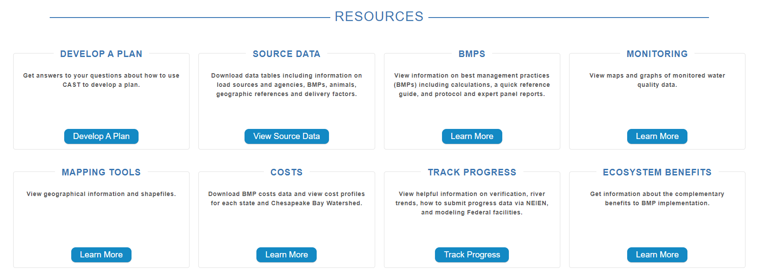
10

Slide 11
Track Progress
View helpful information on verification, river trends, how to submit progress via NEIEN, and modeling Federal Facilities.
View trends for loads, nutrients, animal units and septic systems for Bay jurisdictions from 1984 through 2025.
BMPs implemented
Loads delivered to the streams and the Bay
Wastewater
Nutrients applied to the land
Animal numbers
Septic systems
Manure transport
Tidal water quality trends
11

Slide 12
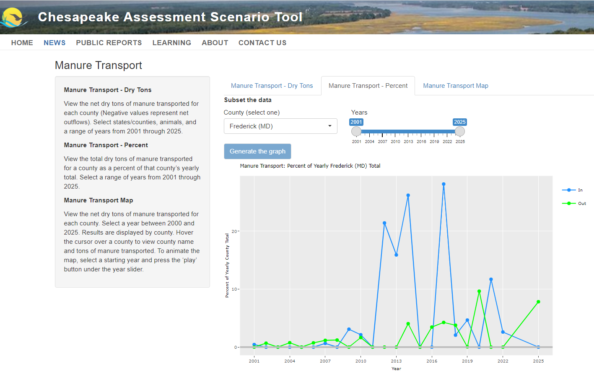
12

Slide 13
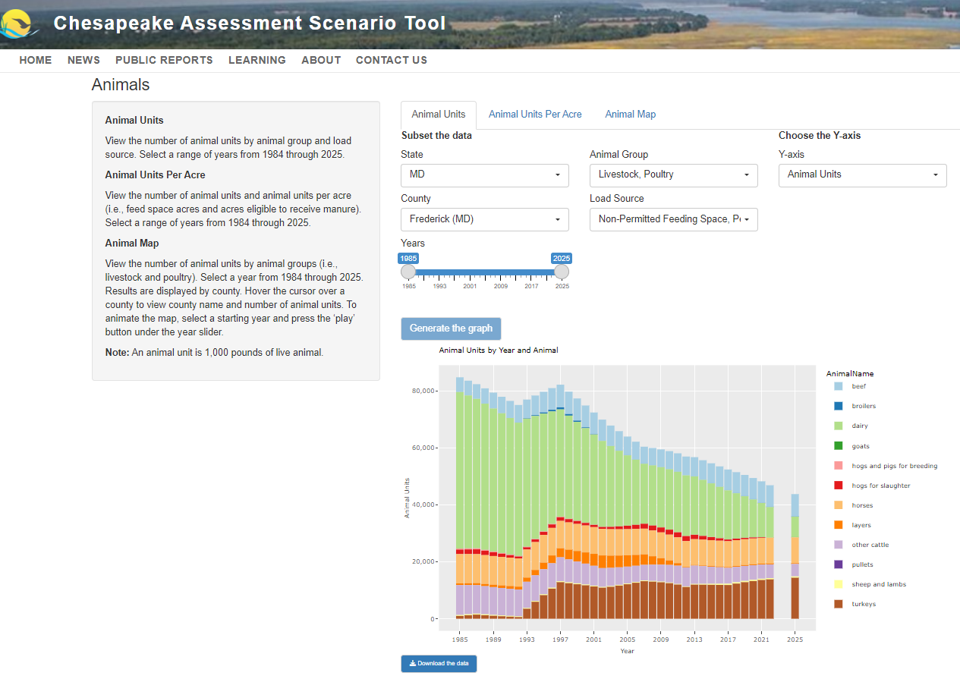
13

Slide 14
Scenarios
1
2
How to create and compare your own, unique scenarios using climate-smart practices as examples
14

Slide 15
NRCS Climate-Smart Agricultural Practices
https://www.nrcs.usda.gov/sites/default/files/2023-10/NRCS-CSAF-Mitigation-Activities-List.pdf
15

Slide 16
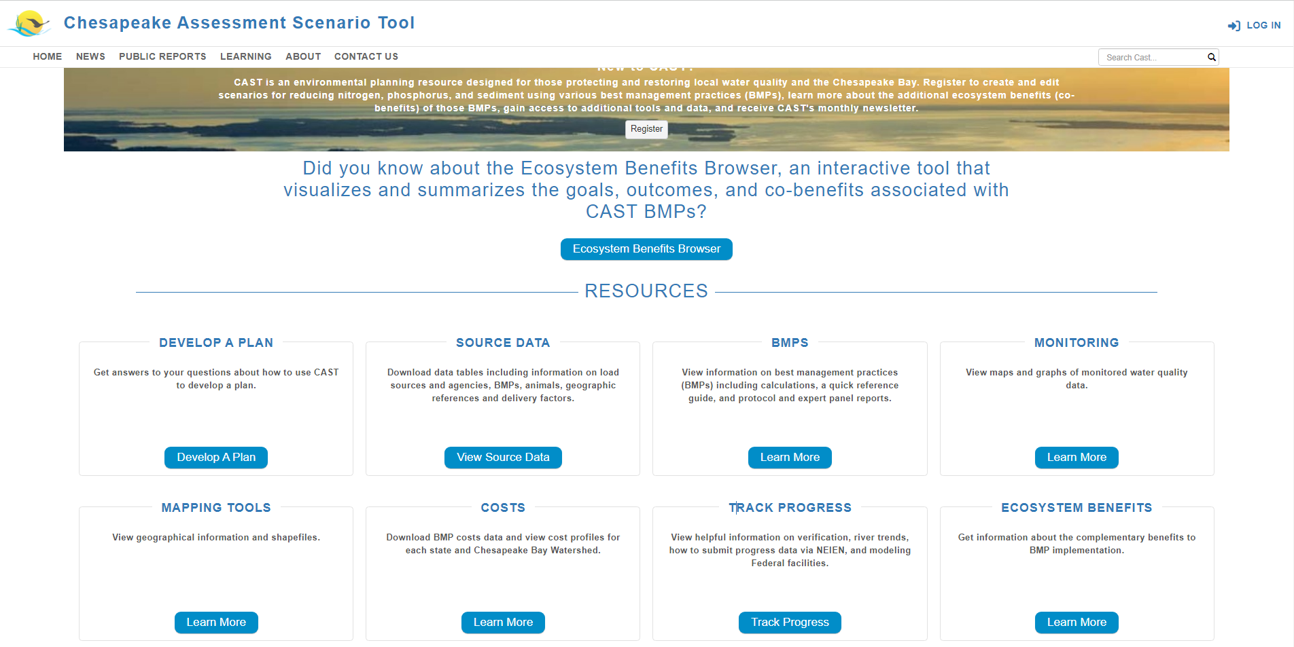
16

Slide 17
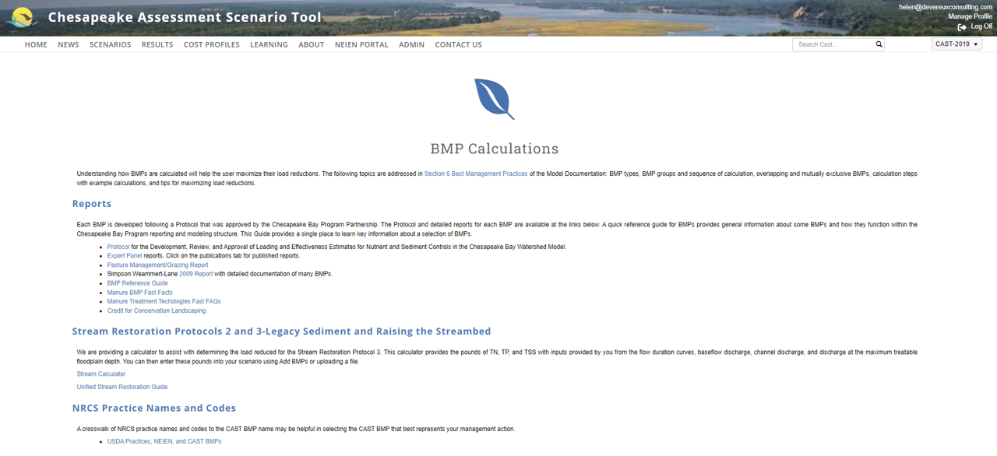
17

Slide 18
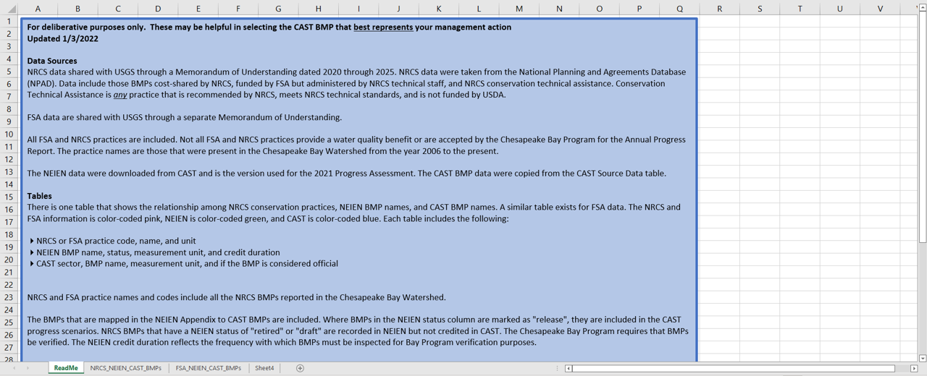
18

Slide 19
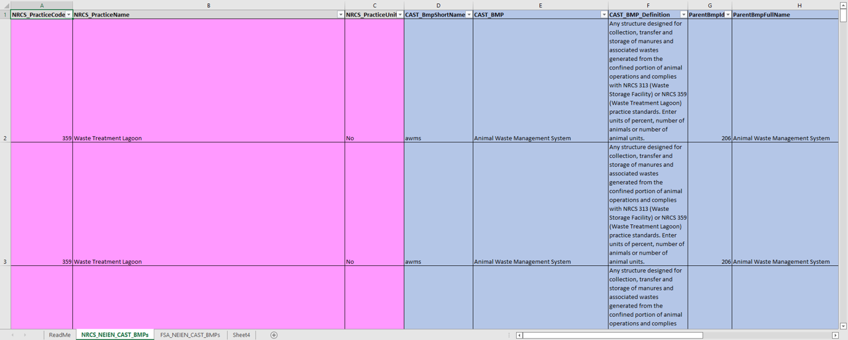
19

Slide 20
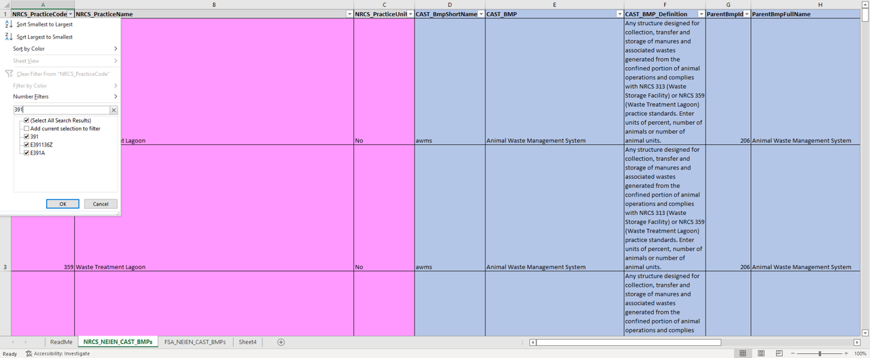
20
Notes:
391=riparian forest buffer

Slide 21
21

Slide 22
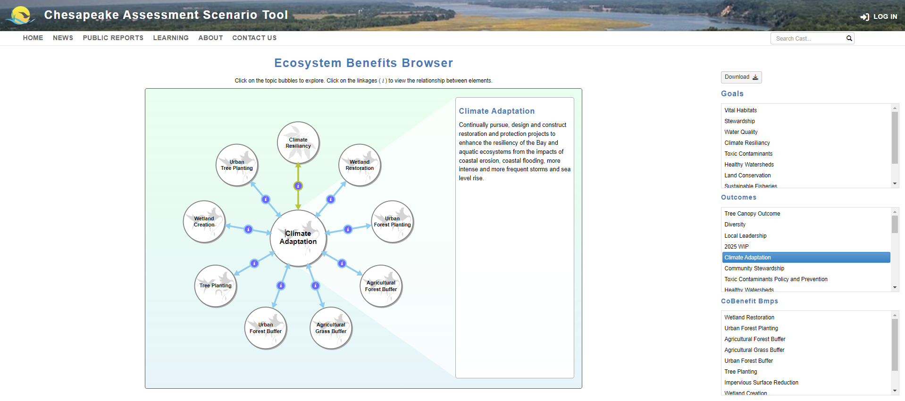
22

Slide 23
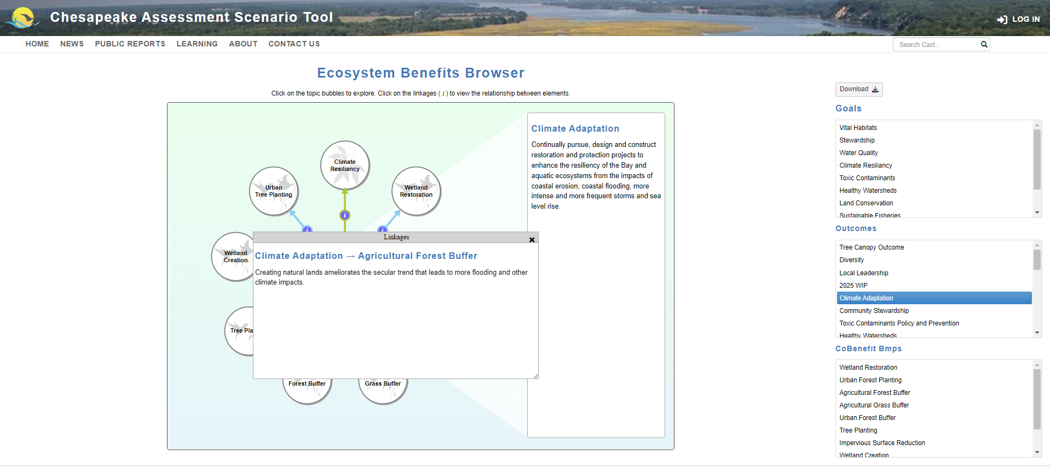
23

Slide 24
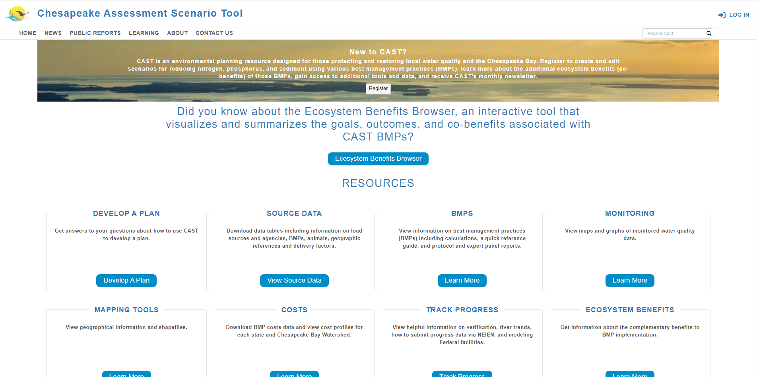
24

Slide 25
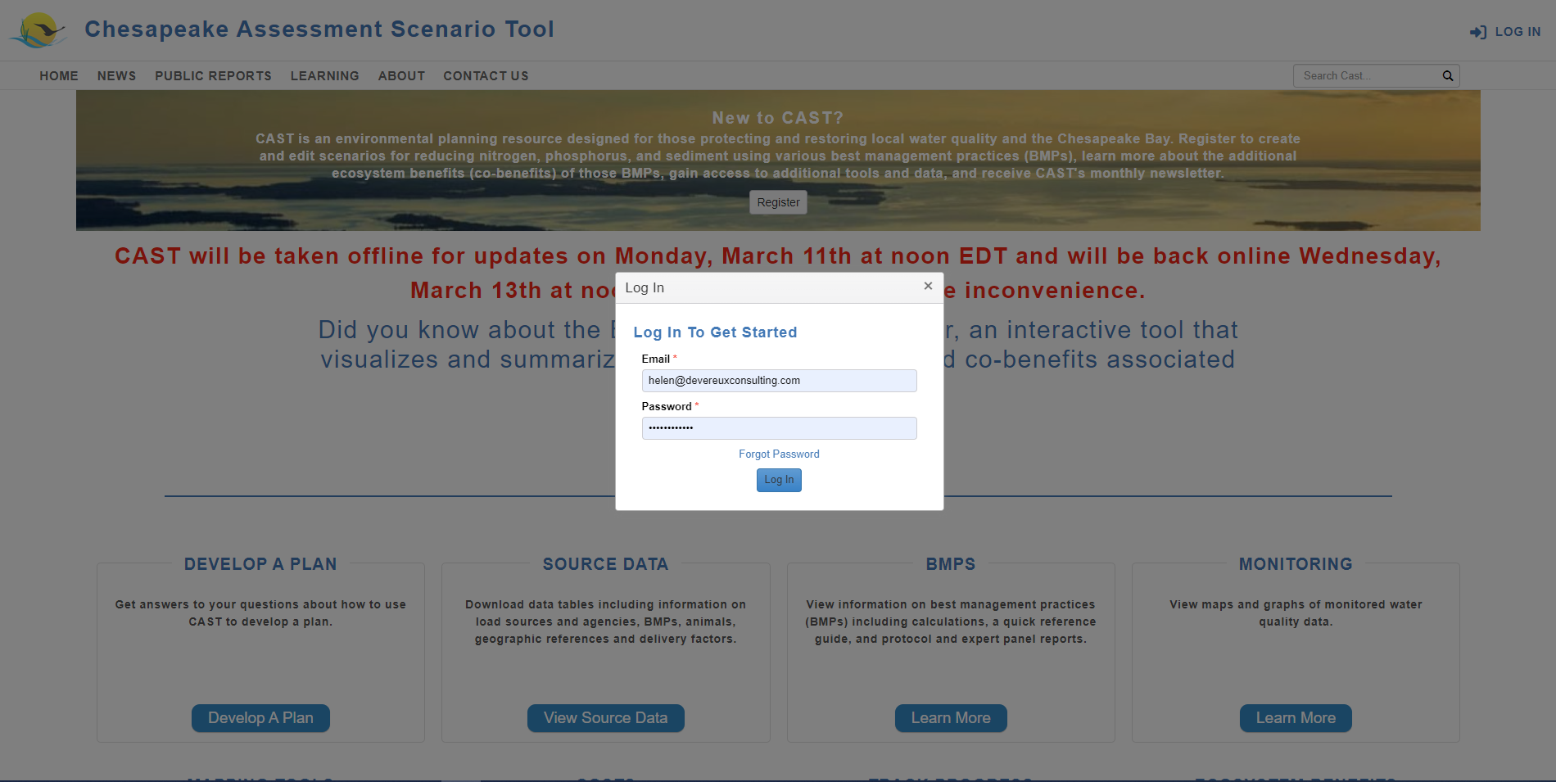
25

Slide 26
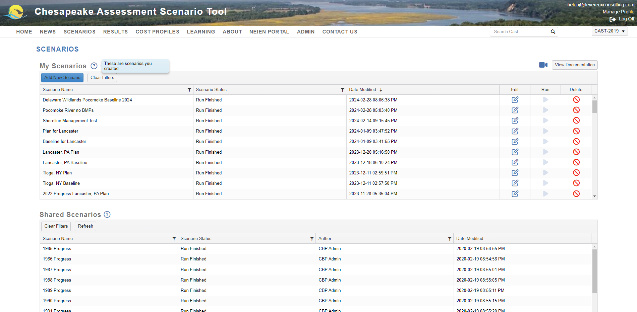
Click ‘Add New Scenario’ button to create a new scenario
26

Slide 27
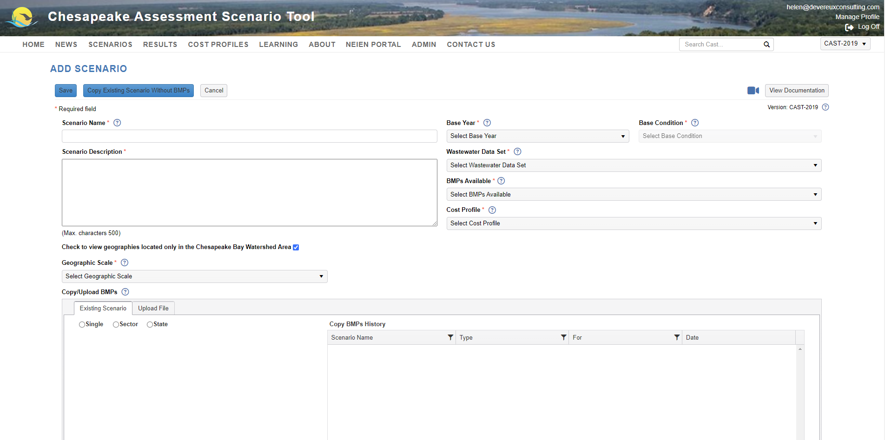
Step 1:
Enter a unique scenario name
27

Slide 28
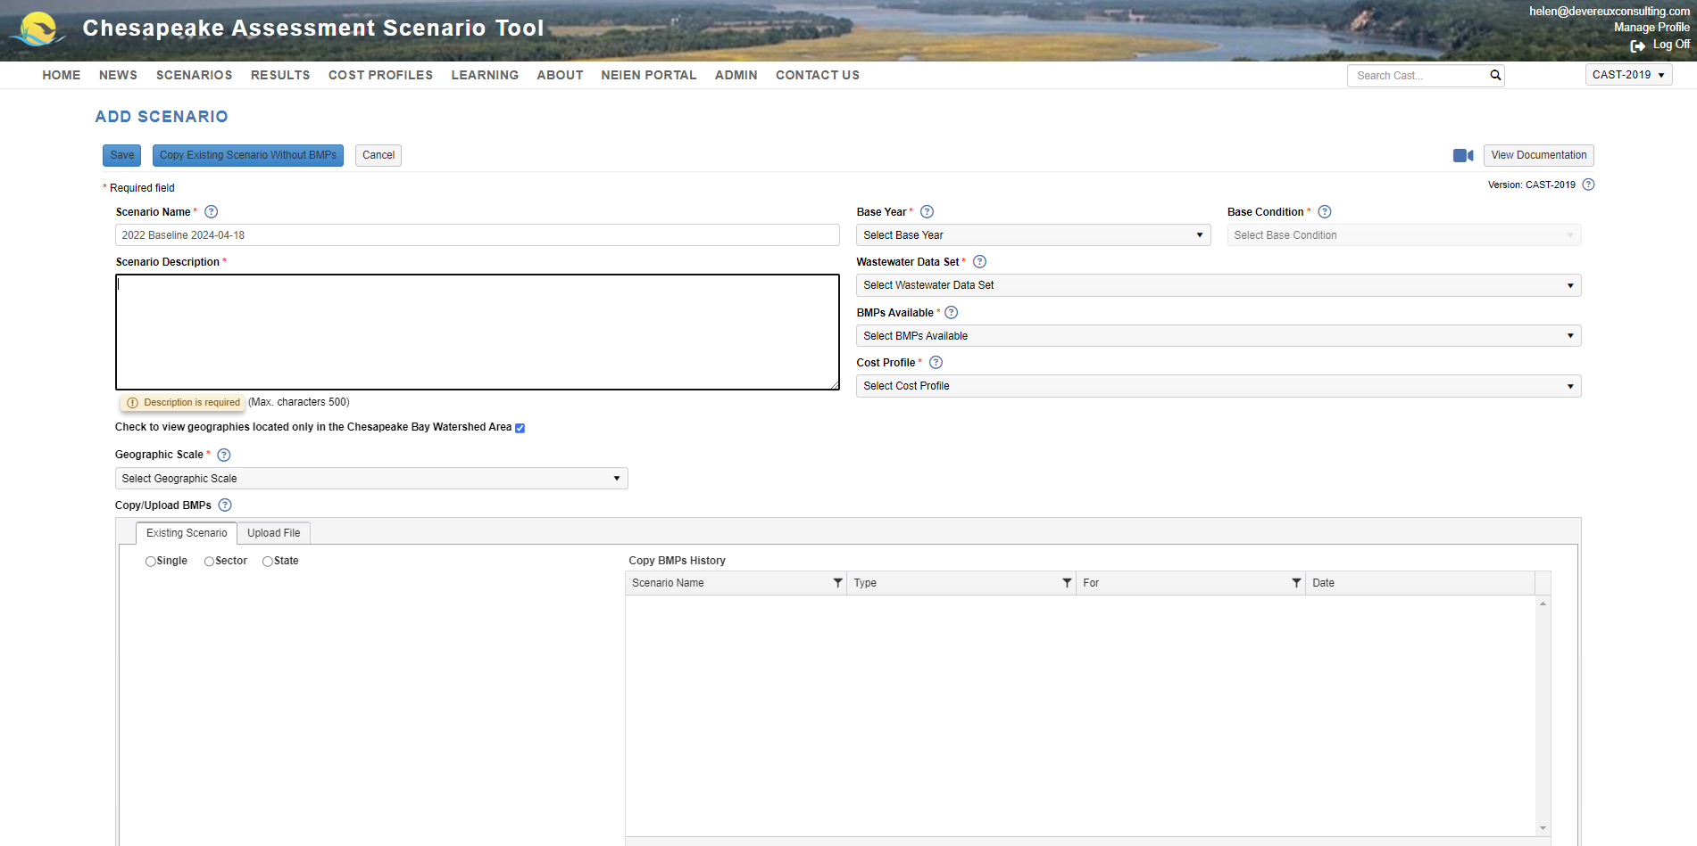
Step 2:
Enter a scenario description
28

Slide 29
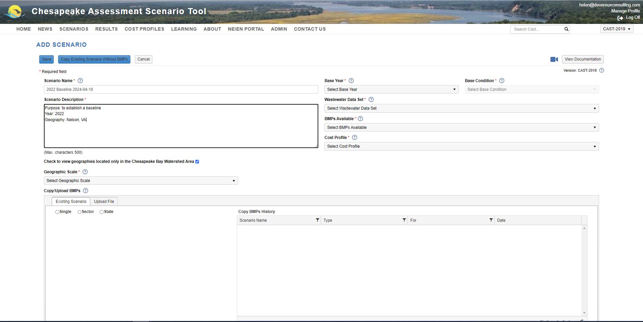
Step 3:
Select a base year
29

Slide 30
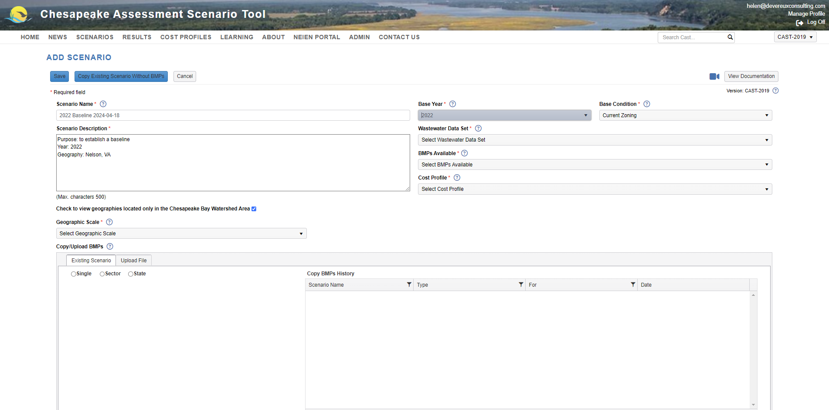
The Base Condition defaults to Current Zoning for all years after 2012.
1984-2012 use Historic Trends.
30

Slide 31
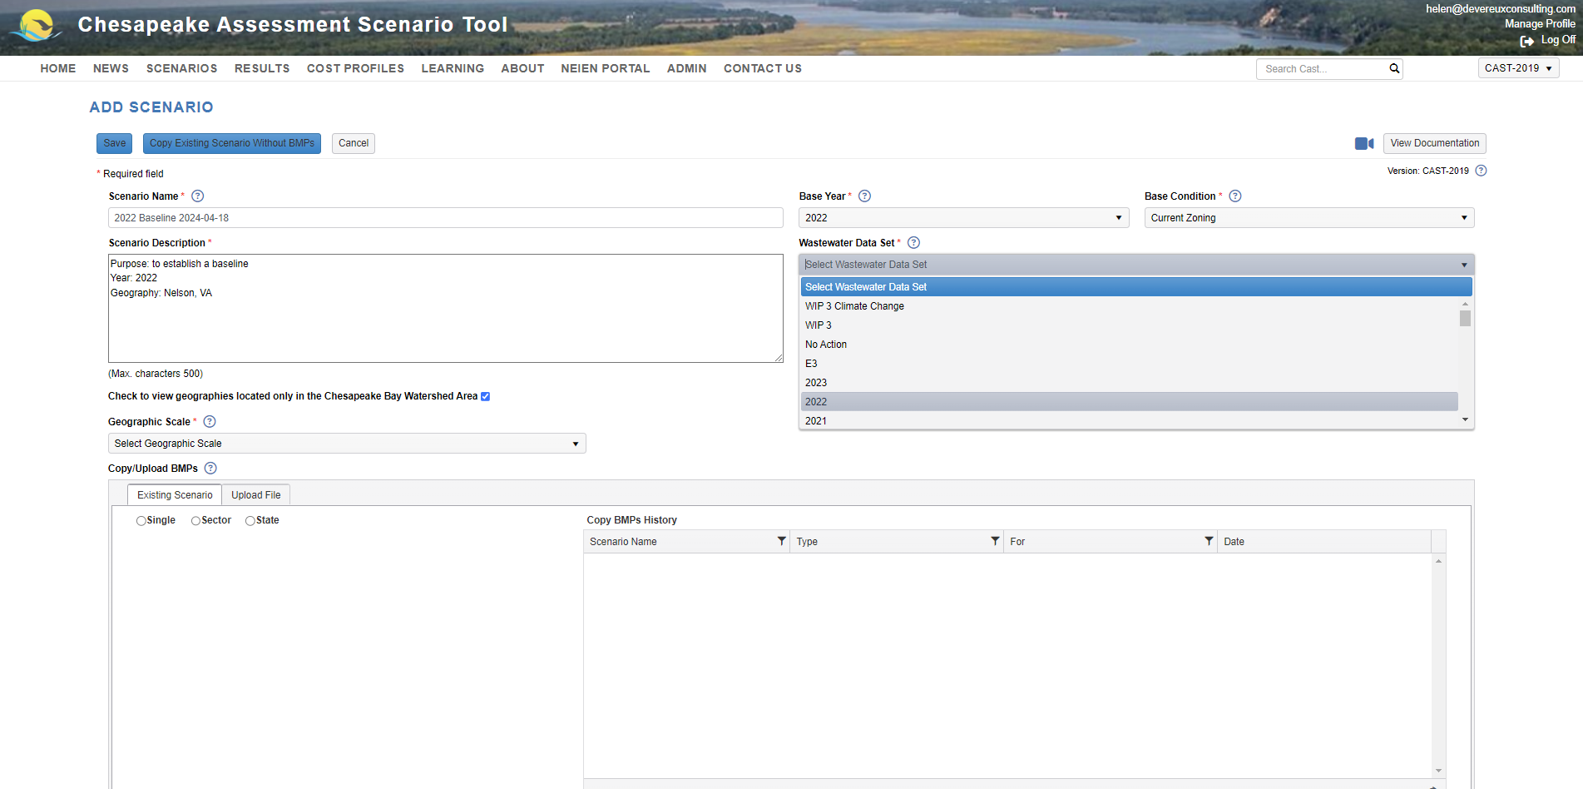
Step 4:
Select the same Wastewater Data Set as your Base Year.
31

Slide 32
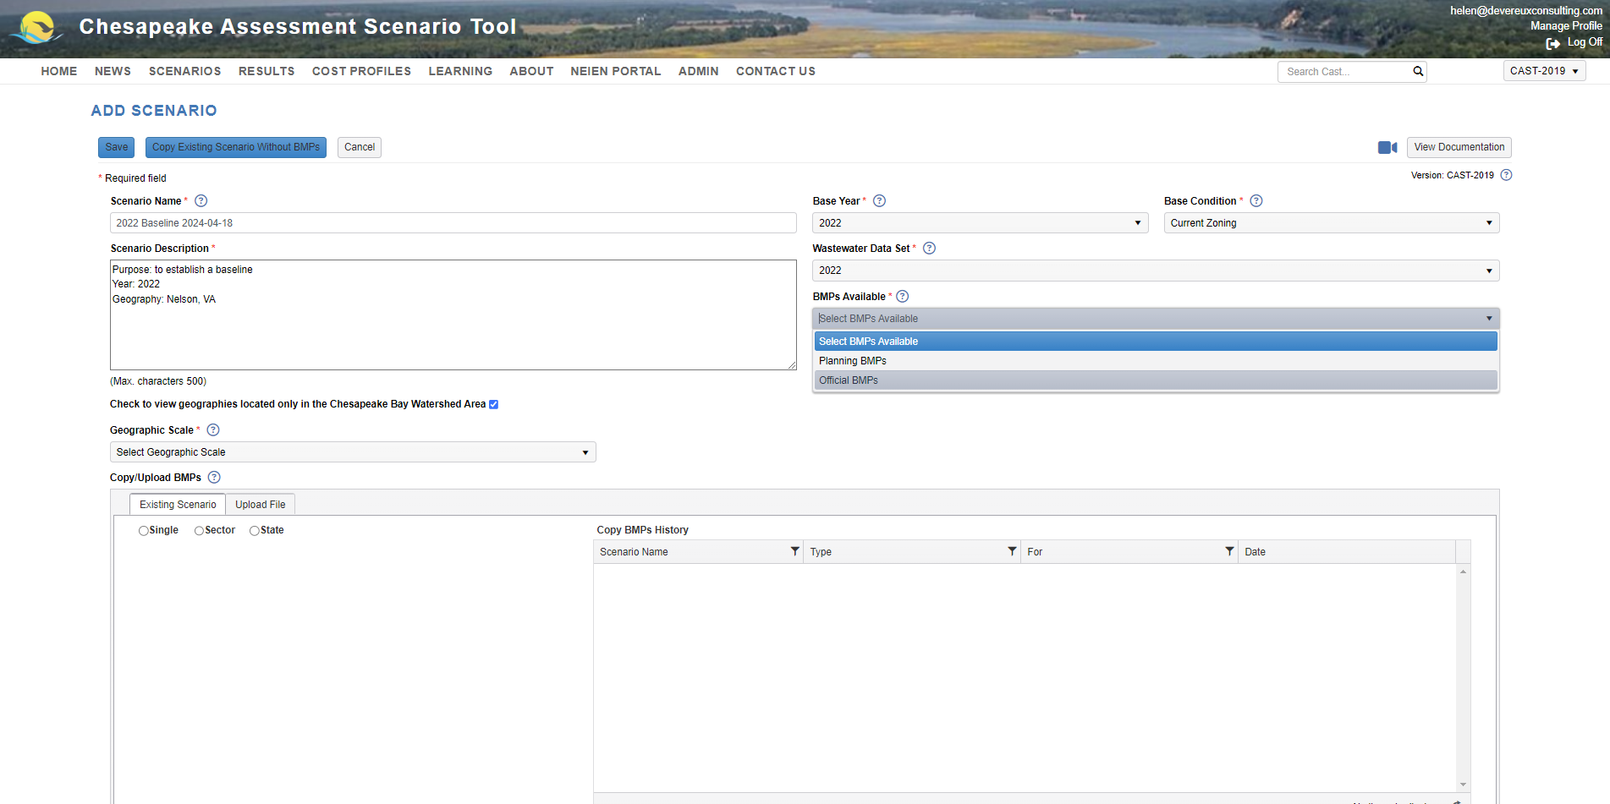
Step 5:
Select Available BMPs
32

Slide 33
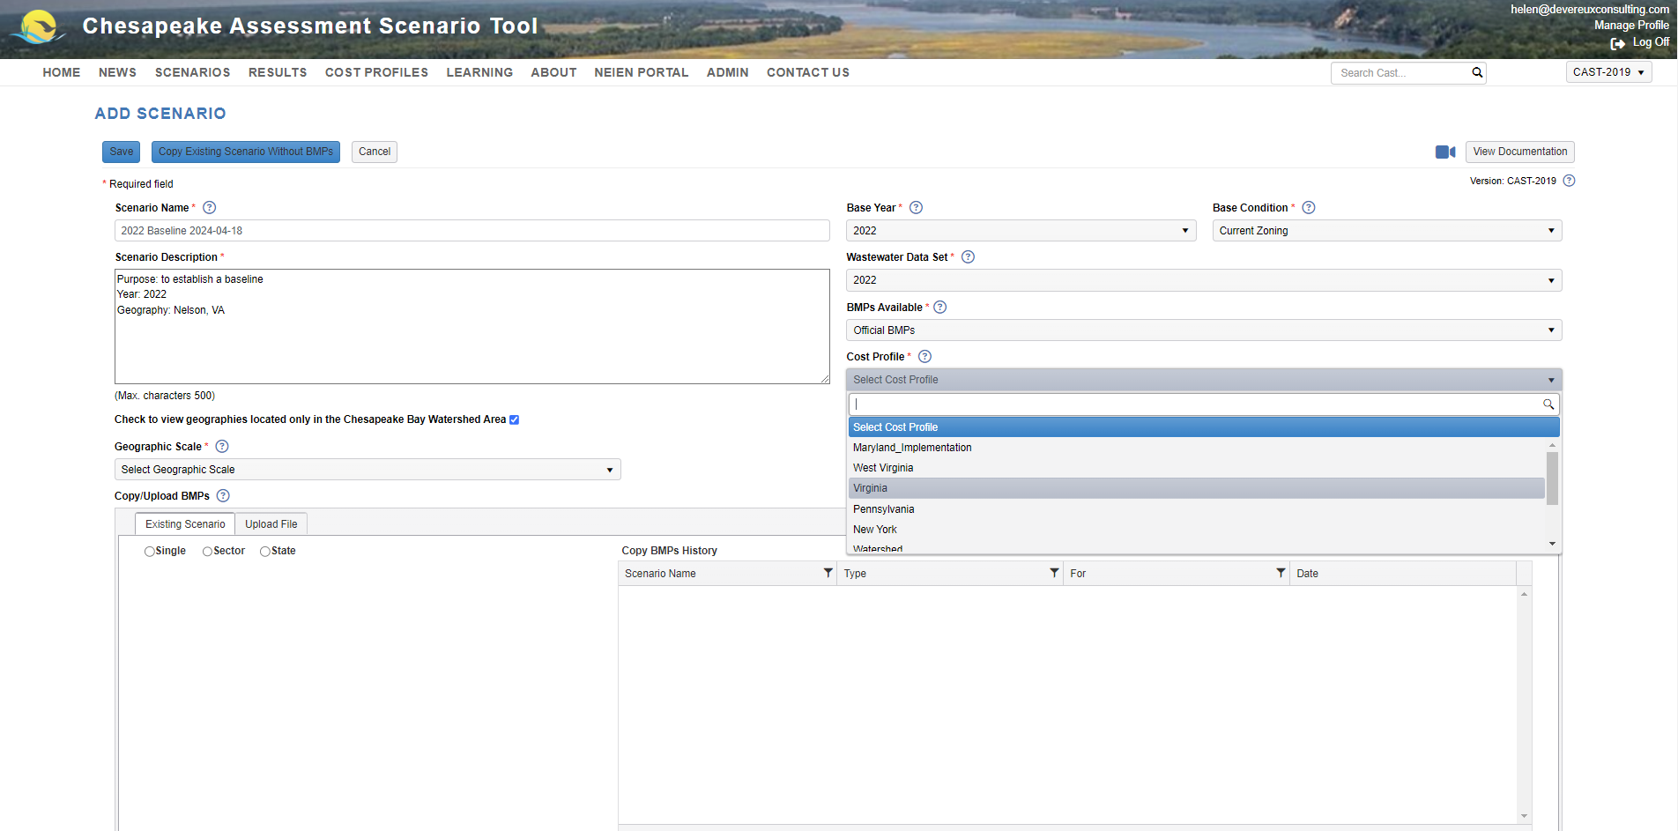
Step 6:
Select a Cost Profile
33

Slide 34
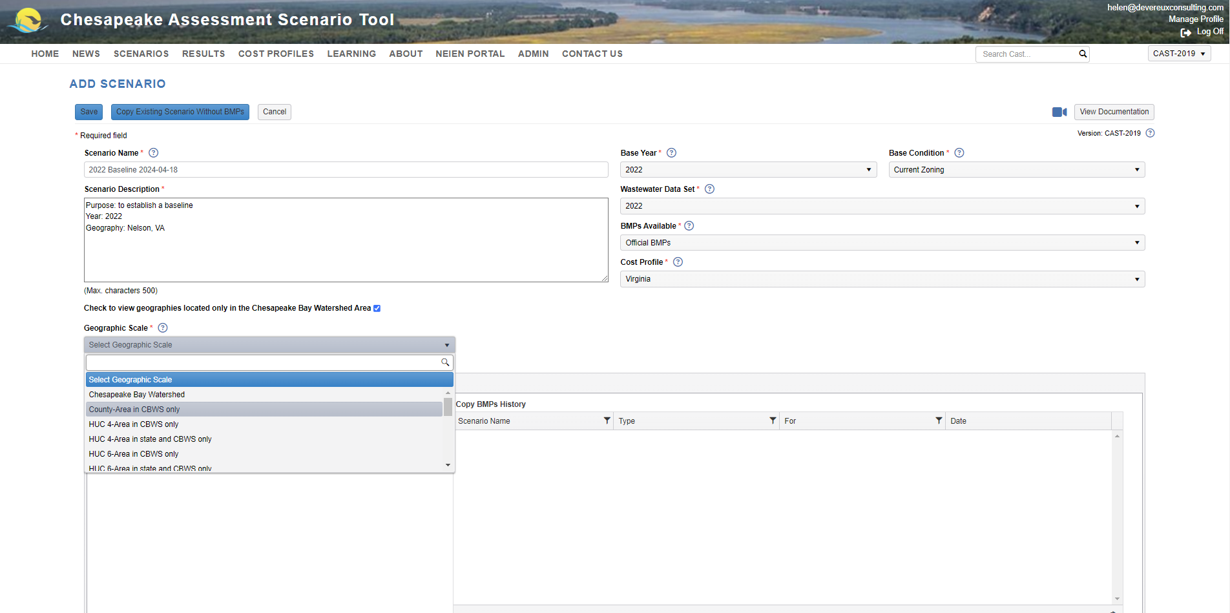
Step 7:
Select a Geographic Scale
34

Slide 35
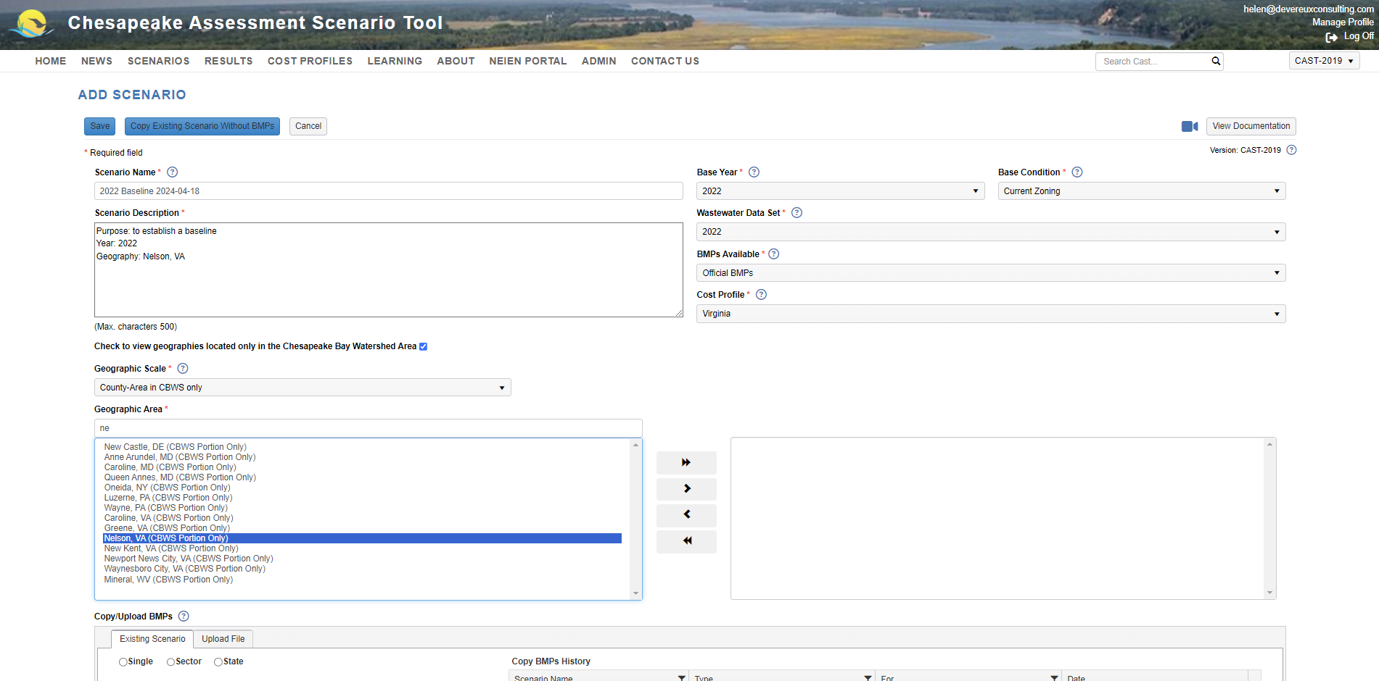
Use the single arrow to move the selected geography or geographies to the right-hand side
Type in the geography you are looking for and select from the list
35

Slide 36
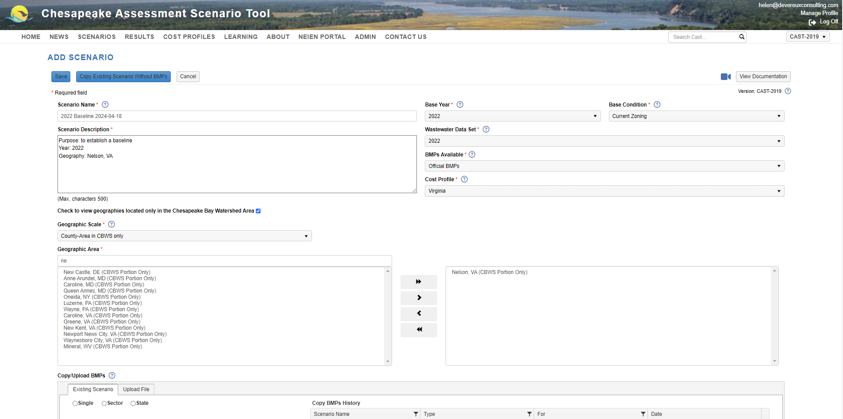
36

Slide 37
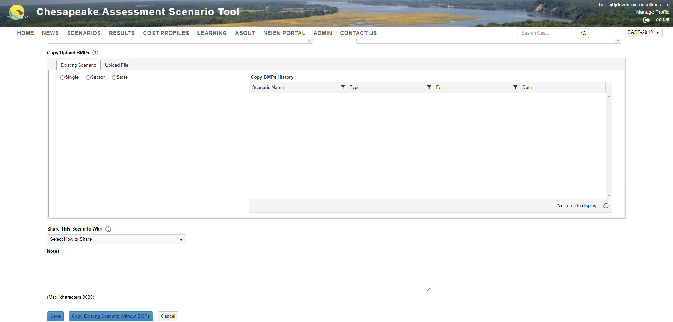
Scroll Down to Copy/Upload BMPs
Select Single to copy BMPs from another scenario
37

Slide 38
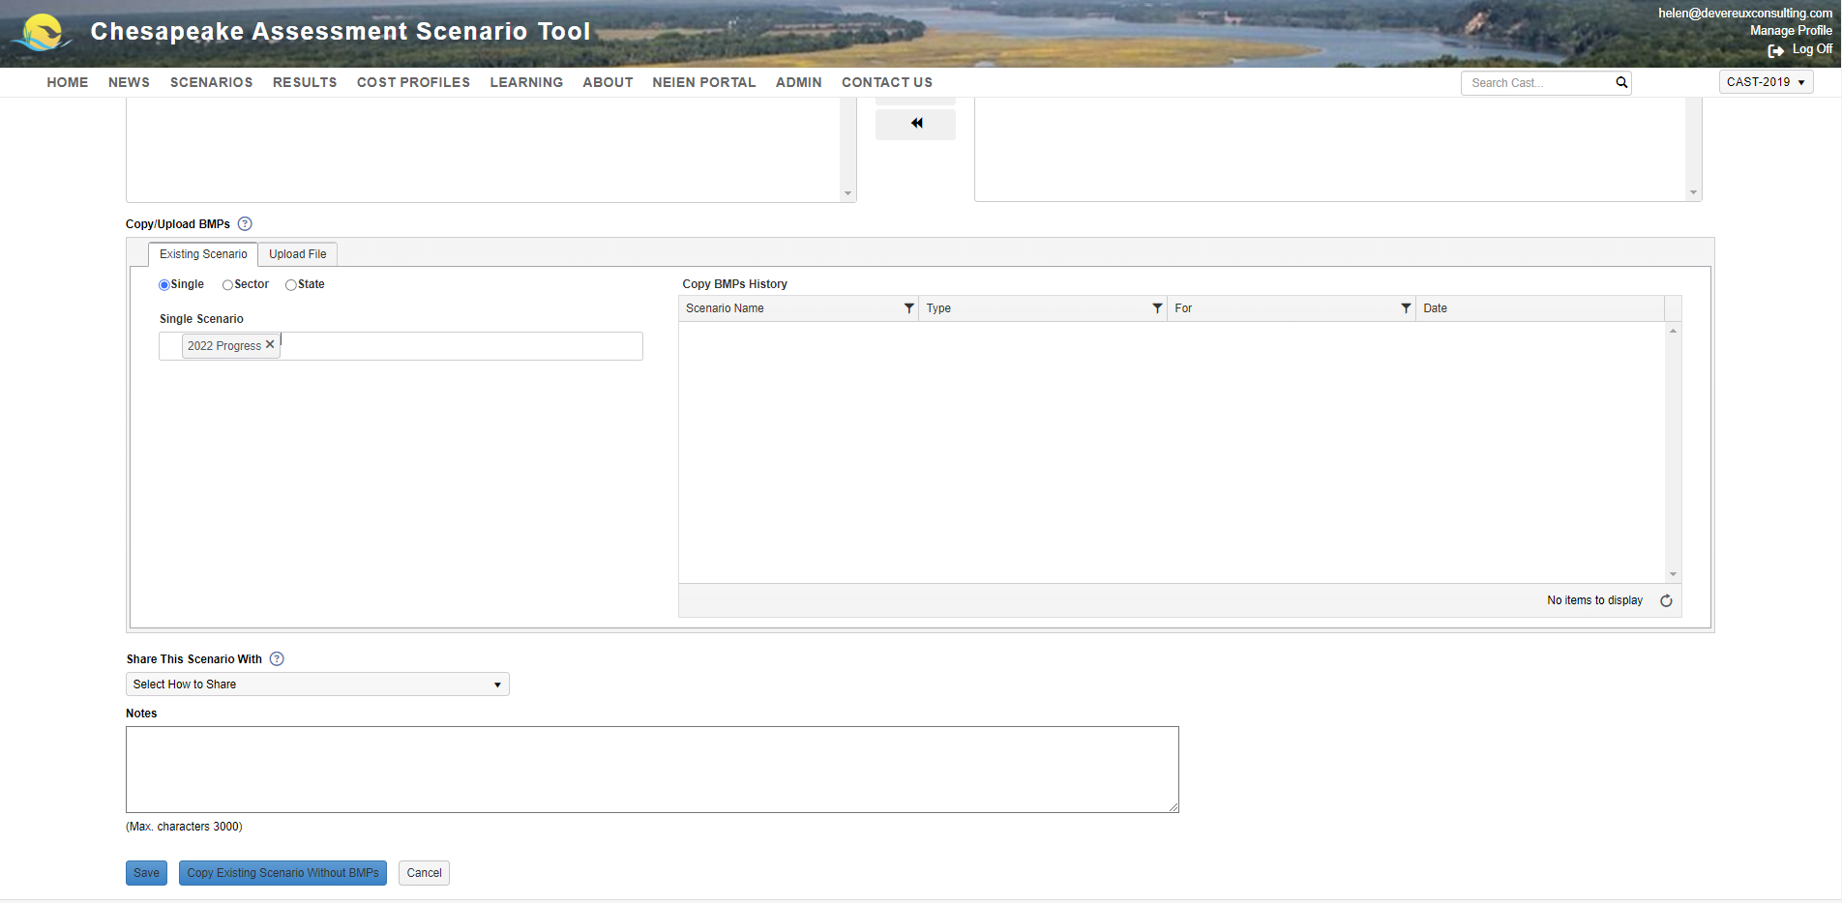
When you’re ready, click Save!
38

Slide 39
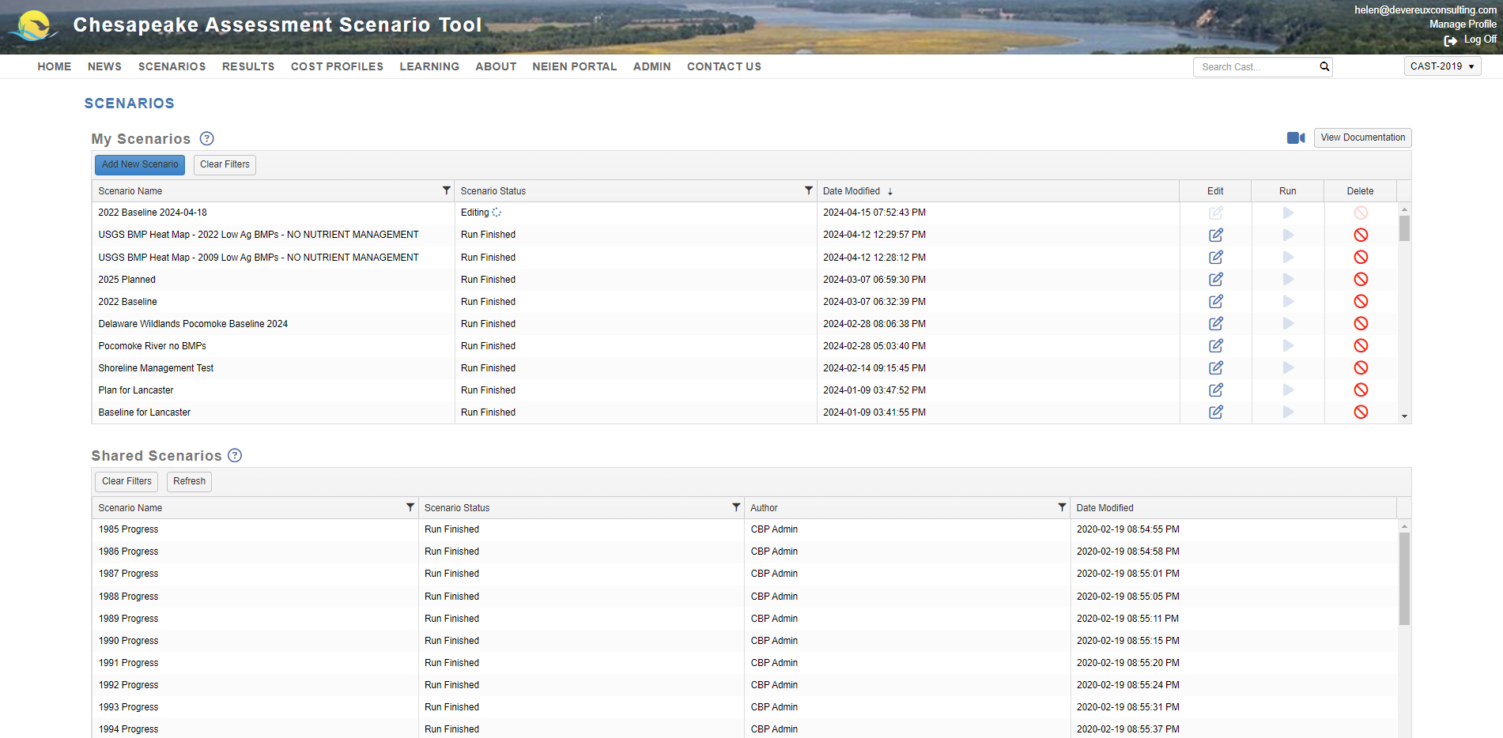
Your new scenario now appears under My Scenarios
39

Slide 40
Click Add New Scenario button to create a planning scenario
40

Slide 41
Tip:
To ensure all base conditions match your baseline, use the Copy Existing Scenario Without BMPs button
41

Slide 42
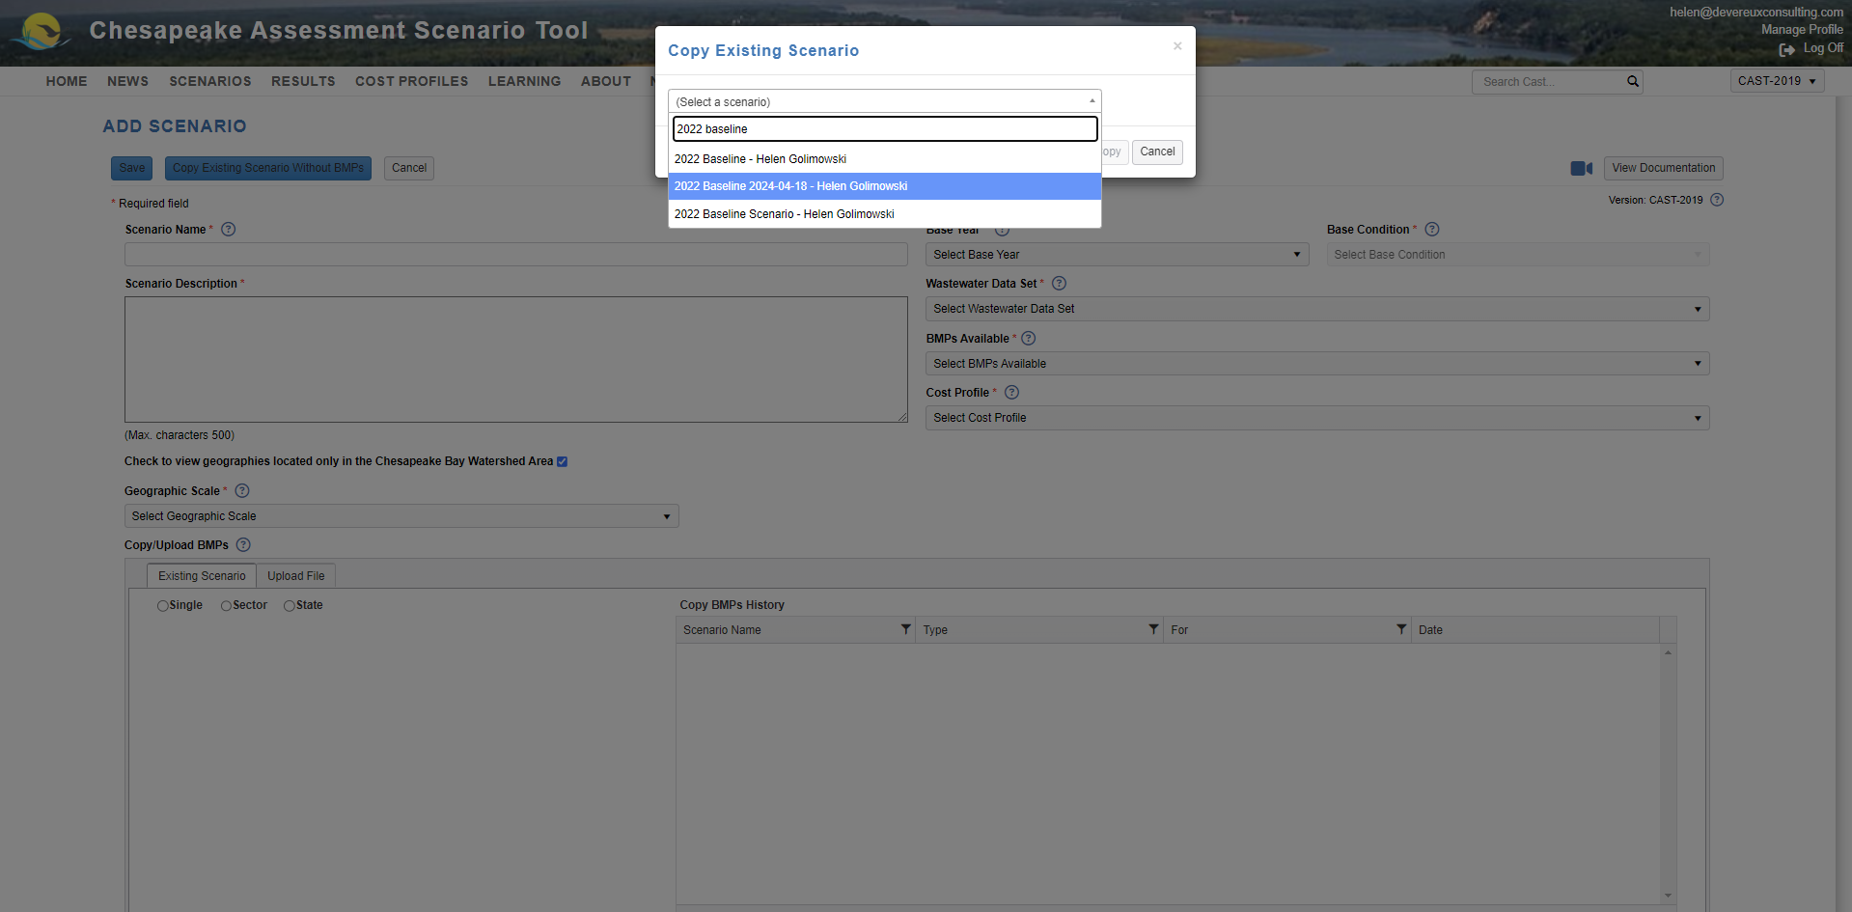
Select your baseline scenario from the drop-down-list
42

Slide 43
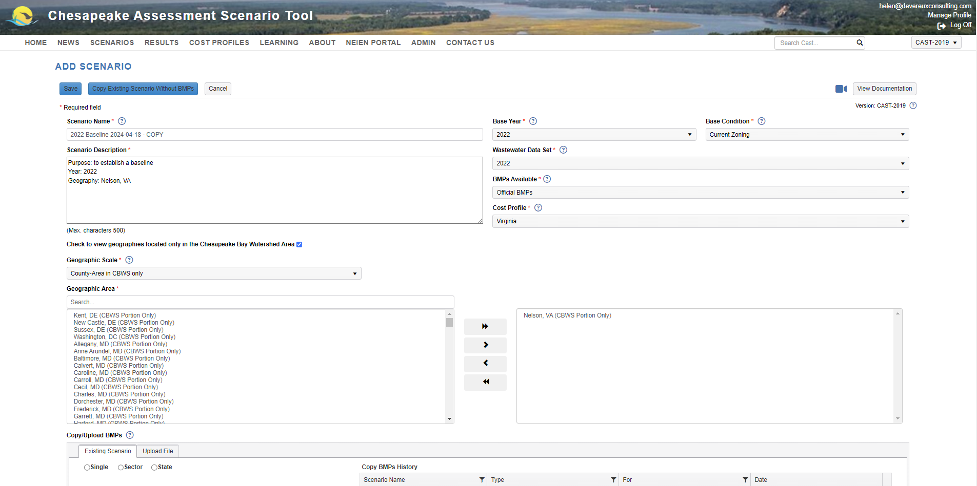
Edit Name and Description to reflect that this is a planning scenario
43

Slide 44
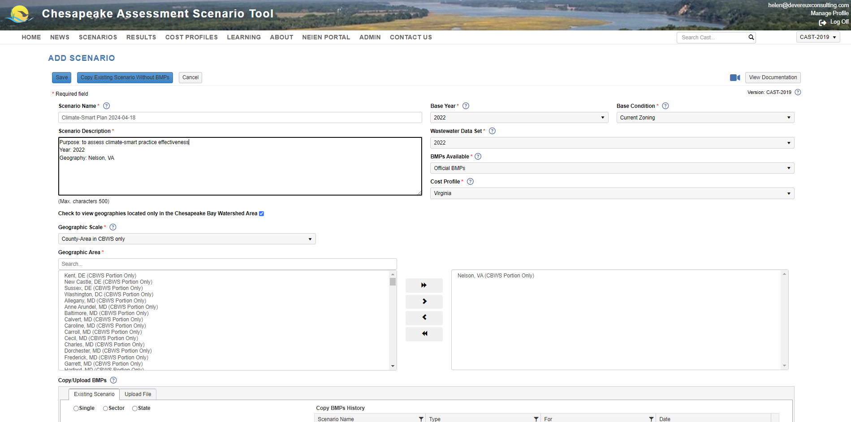
44

Slide 45
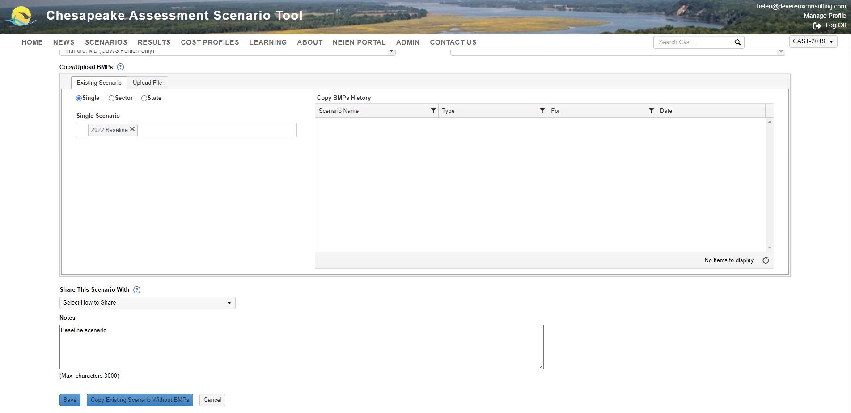
Add the BMPs from your baseline scenario
Click Save
45

Slide 46
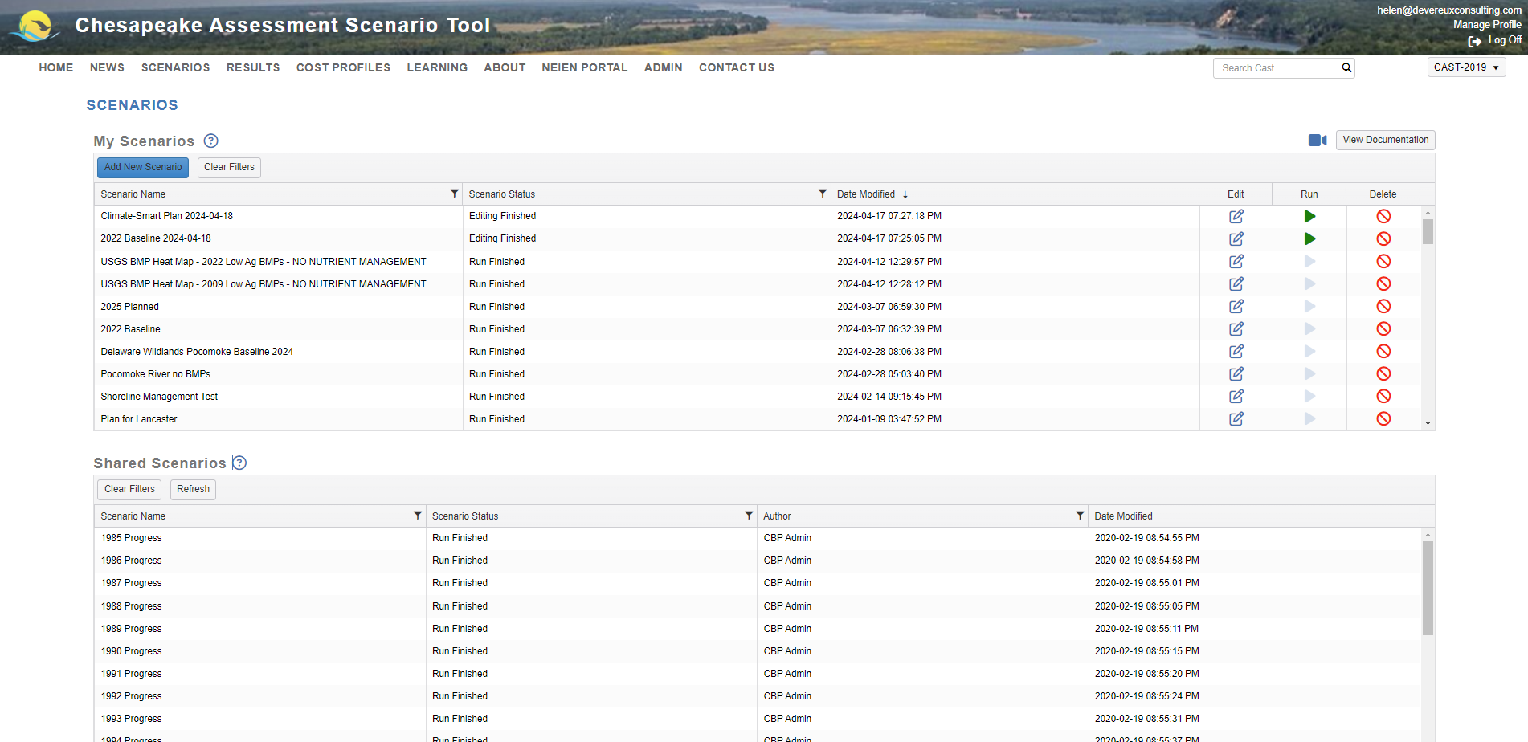
To add BMPs to your plan scenario, click the Edit icon
46

Slide 47
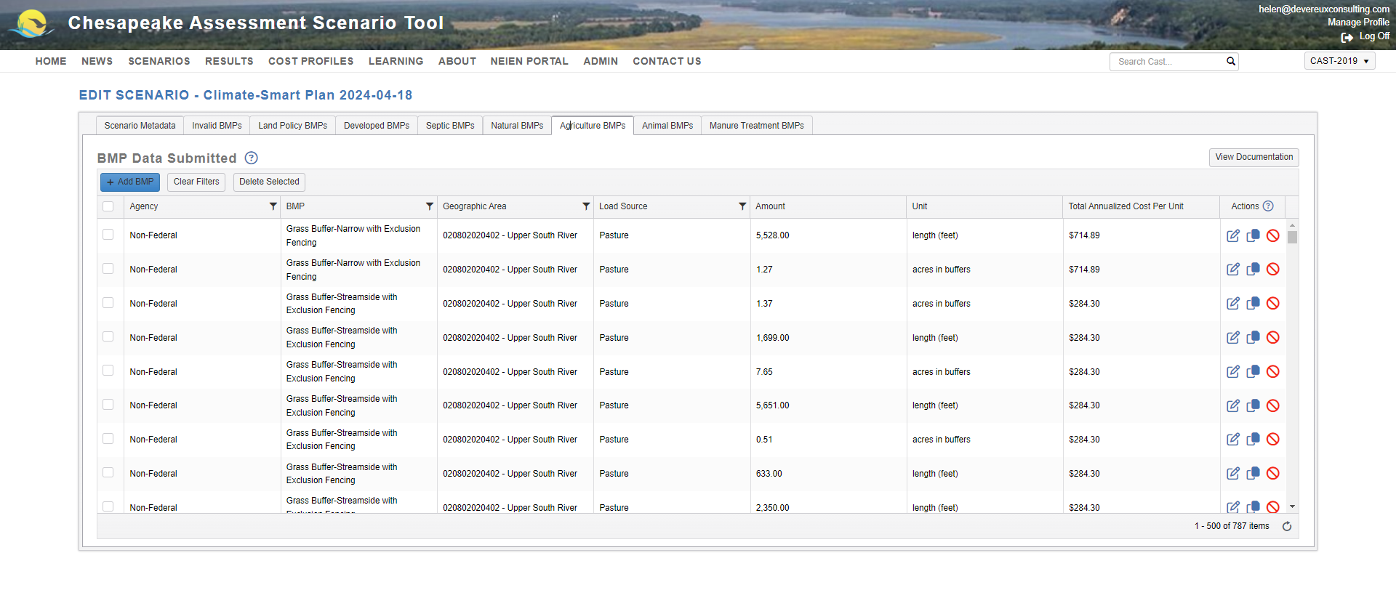
47

Slide 48
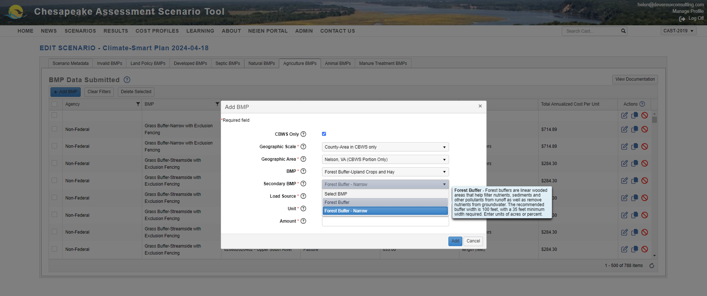
48

Slide 49
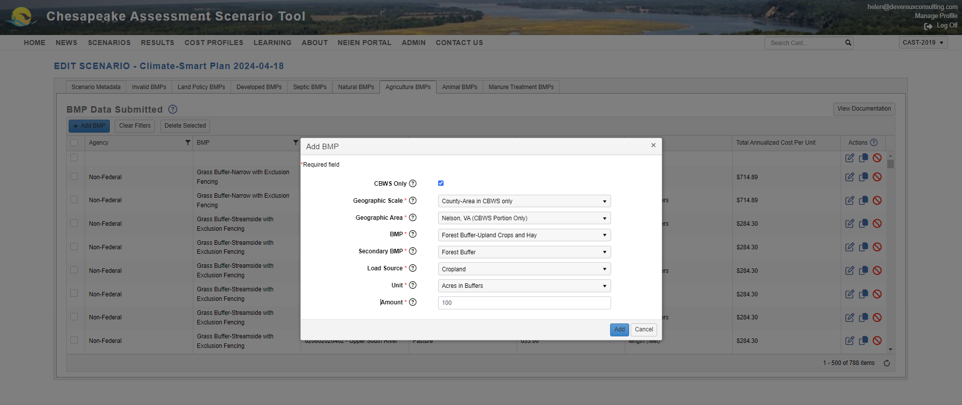
When you’re ready, click Add
49

Slide 50
Your new BMP now appears at the top of the BMP list
50

Slide 51
When you’re done adding BMPs, go back to Scenarios
51

Slide 52
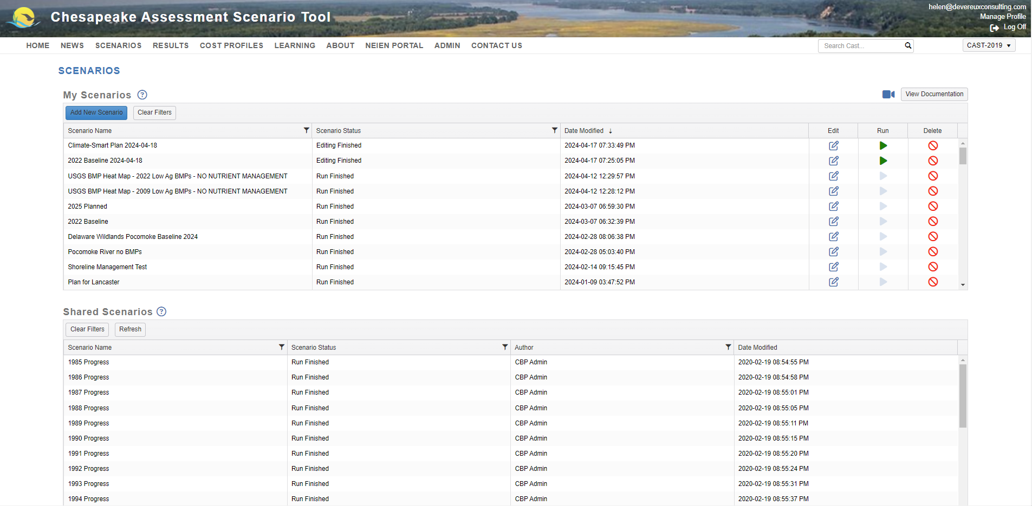
52

Slide 53
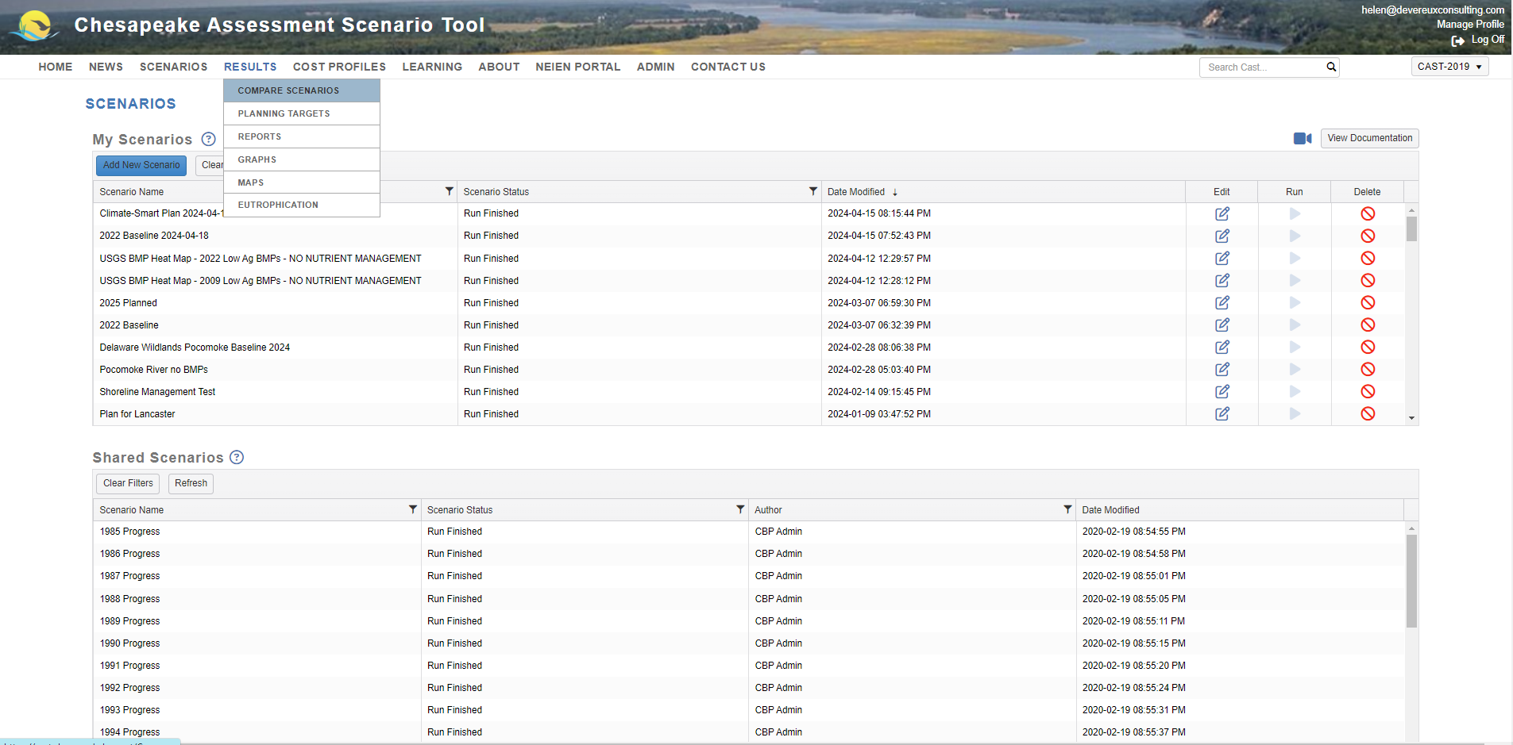
53

Slide 54
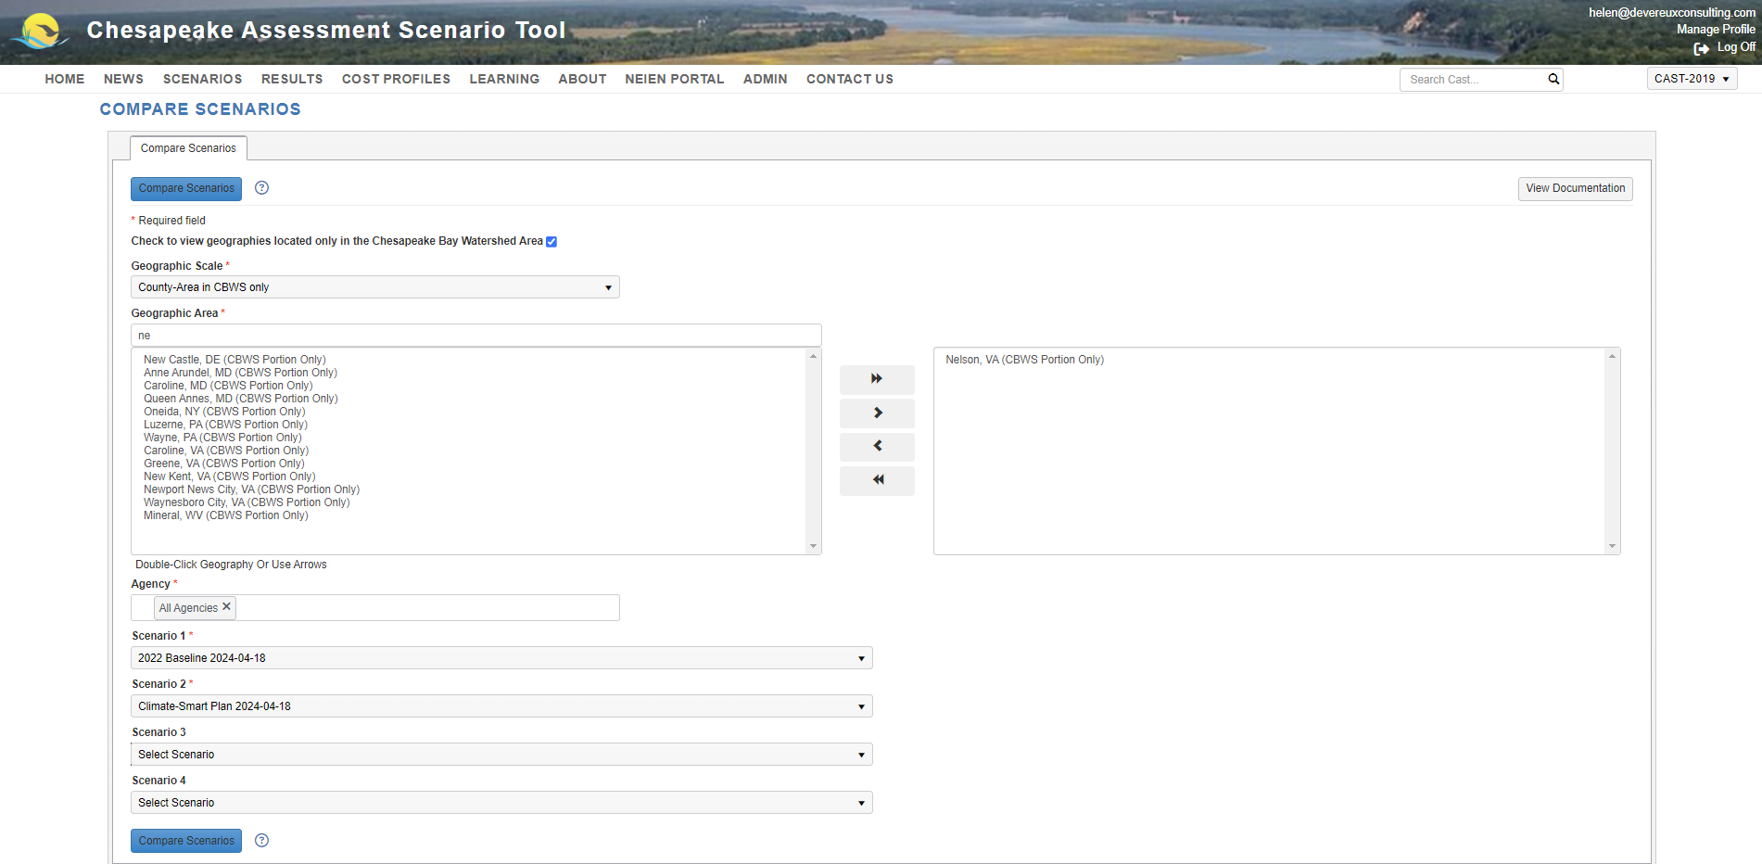
54

Slide 55
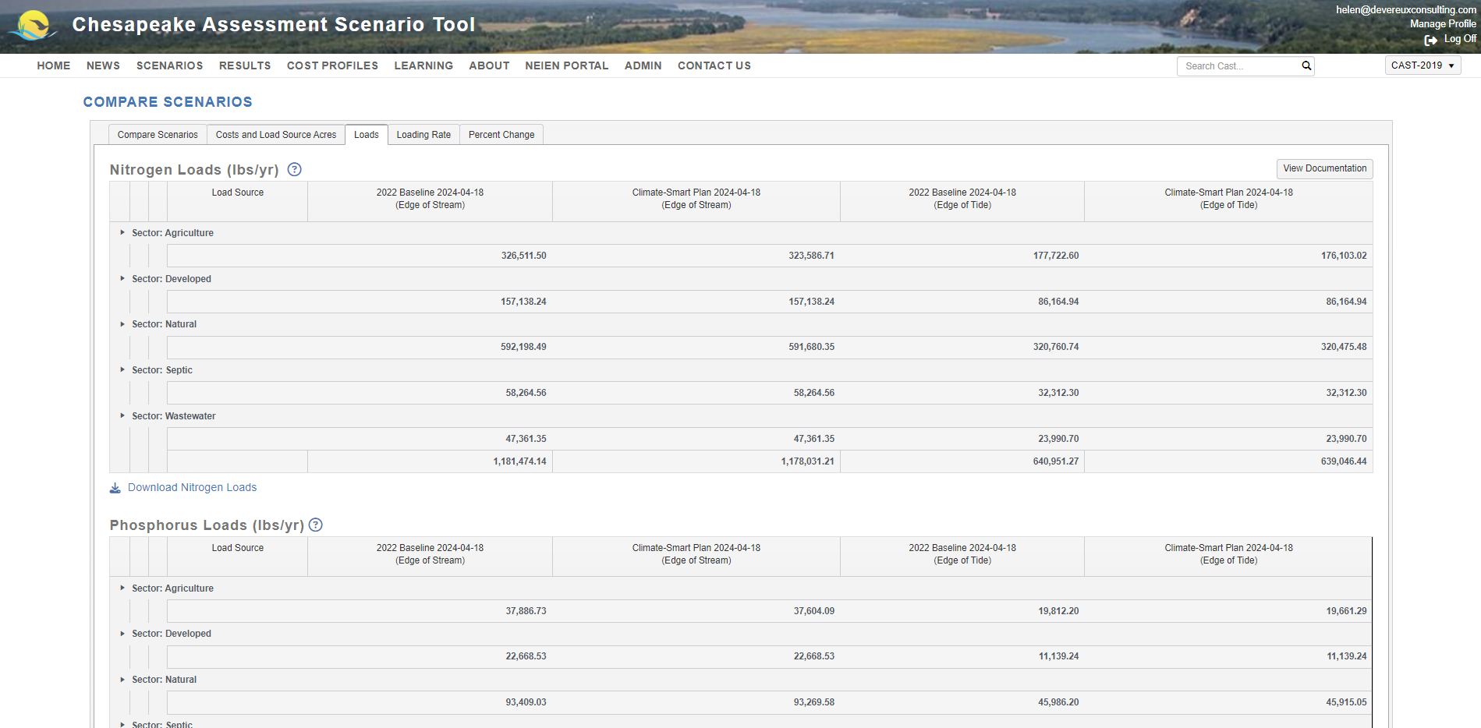
Click the arrows to expand
55

Slide 56
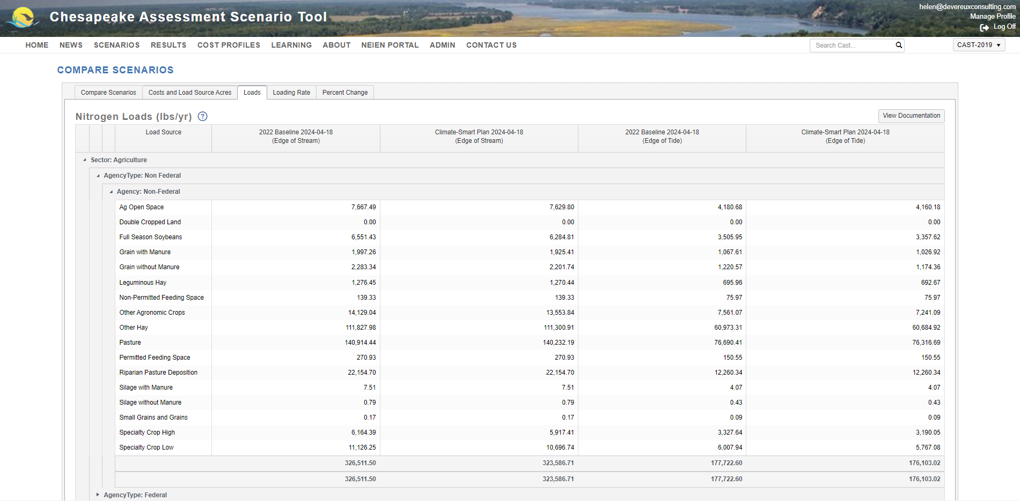
56
Notes:
If goal not achieved, can go back and add more BMPs to your planning scenario.

Slide 57
Project Level Outcomes
1
3
How to generate various types of reports at different geographic scales and how to assess ecosystem benefits of practices
57

Slide 58
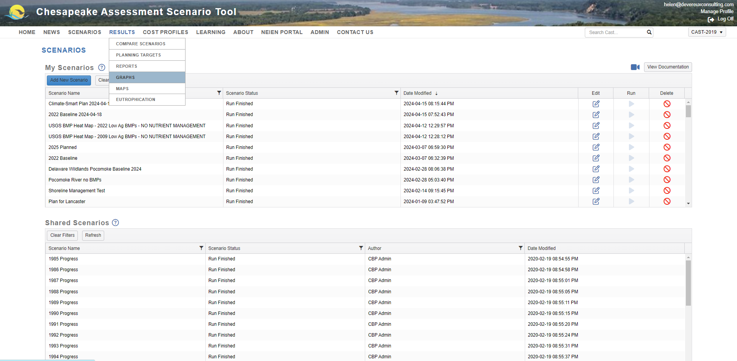

Slide 59
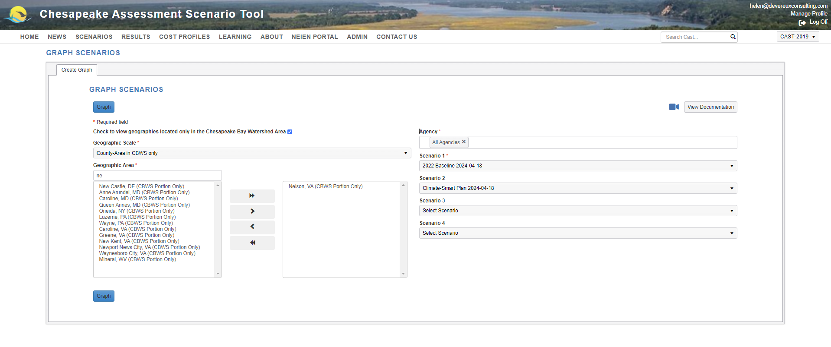

Slide 60
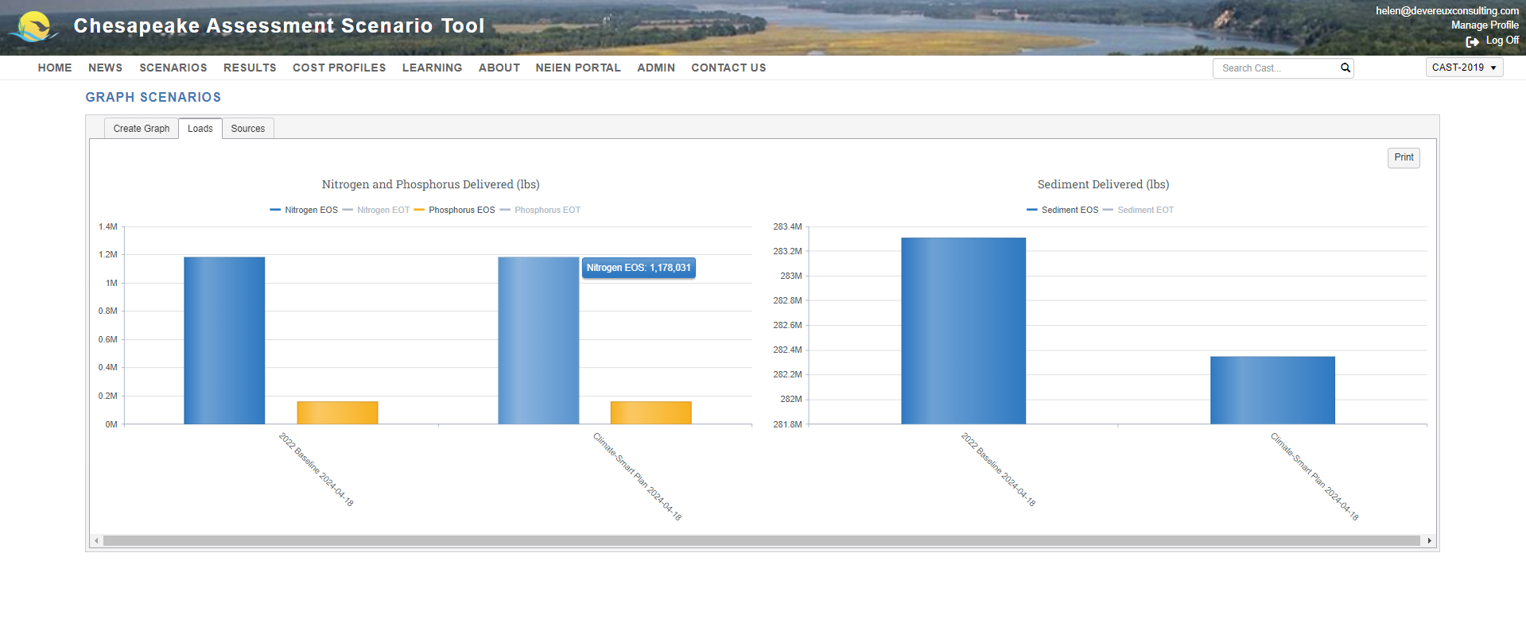
Click the legend to select/deselect N or P at EOS or EOT
Hover your mouse over the bars in the graph to see exact loads

Slide 61
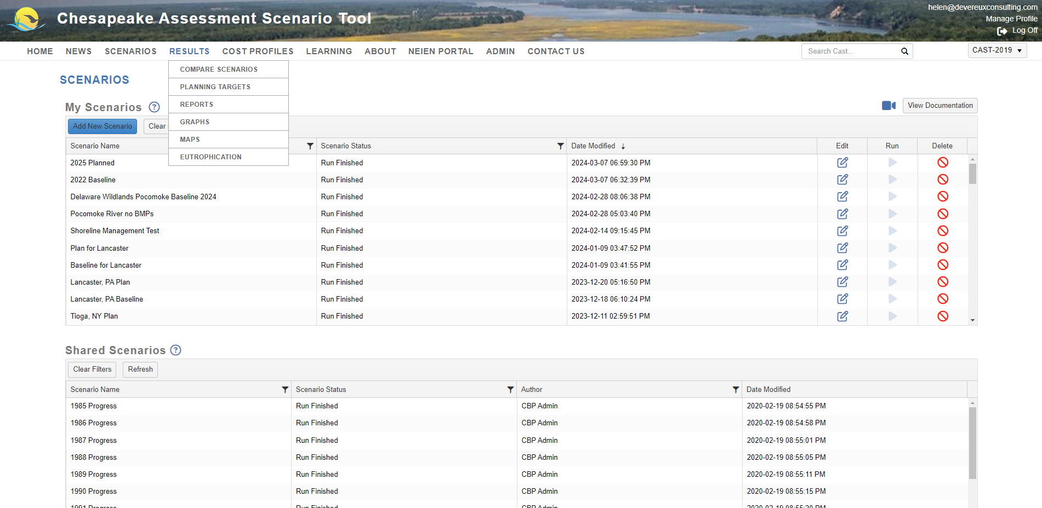

Slide 62
Reports
Atmospheric Deposition Report
Base Conditions Report
BMP Input Files
BMP Submitted vs. Credited Report
BMP Summary Report
Loads Per Unit
Loads Report
Quick Results Report
Wastewater Report

Slide 63
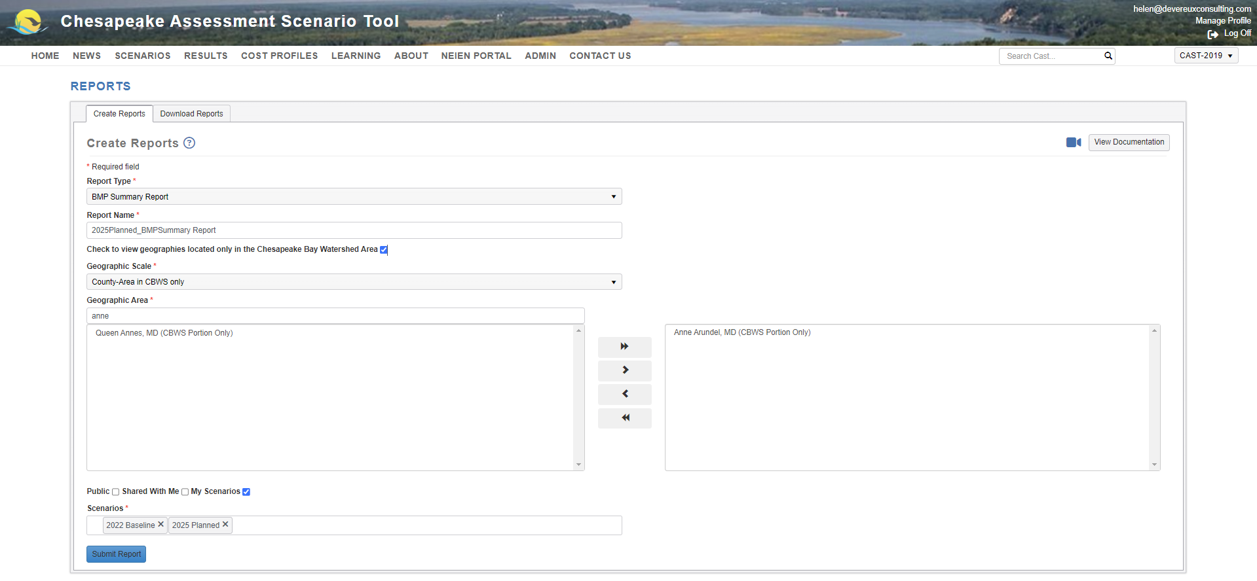
Notes:
Different scenarios than previous example. Here it is Anne Arundel and current vs. planned for the same year to show the difference that a few practices could make.

Slide 64
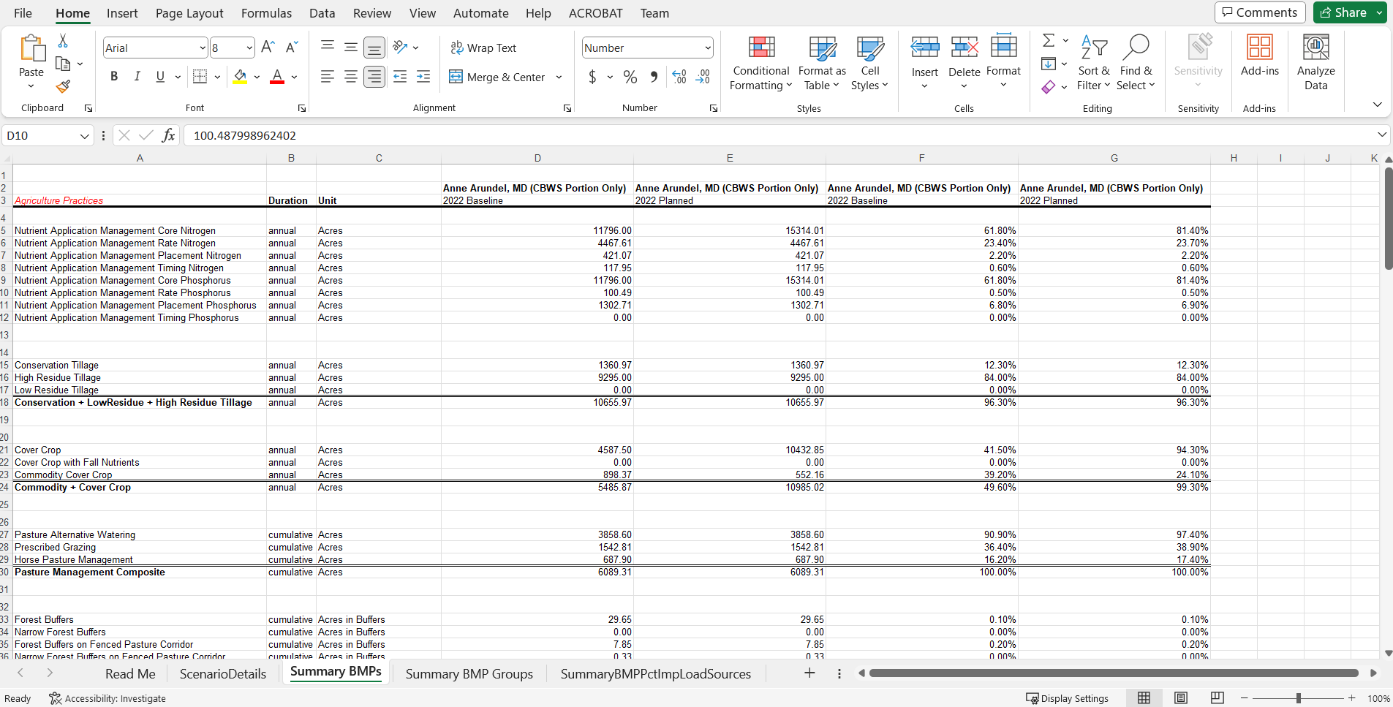

Slide 66
Reports
Atmospheric Deposition Report
Base Conditions Report
BMP Input Files
BMP Submitted vs. Credited Report
BMP Summary Report
Loads Per Unit
Loads Report
Quick Results Report
Wastewater Report

Slide 67
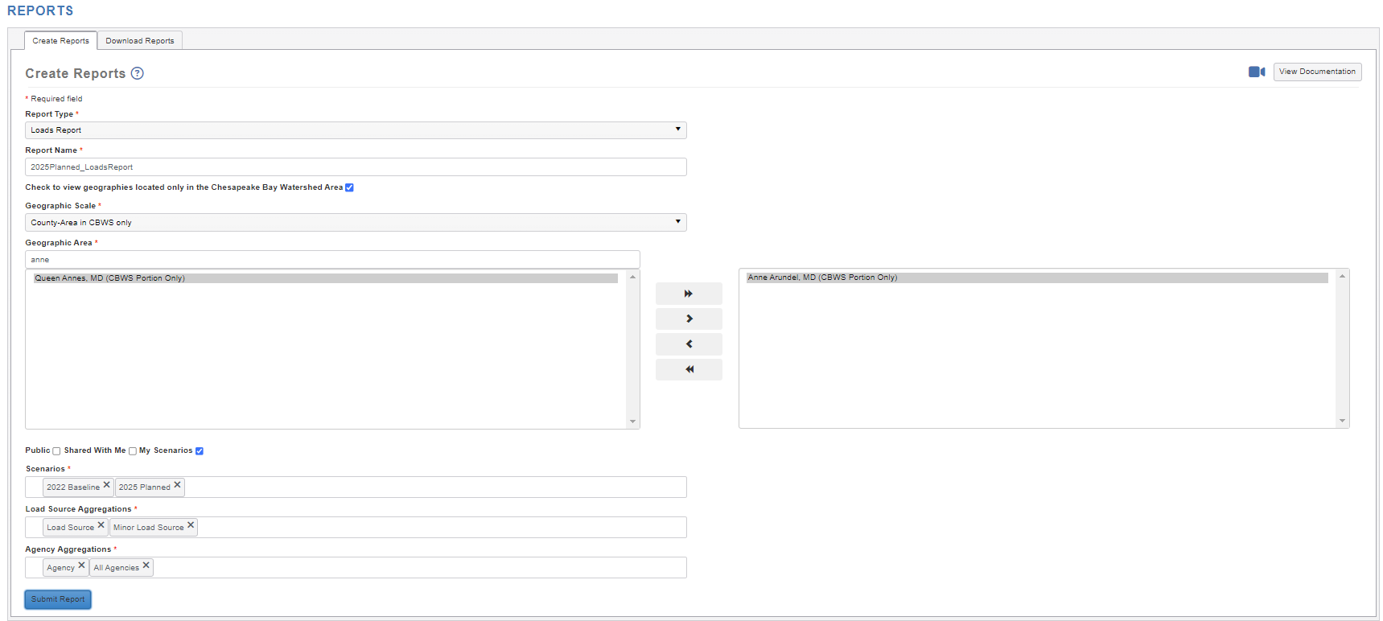

Slide 68
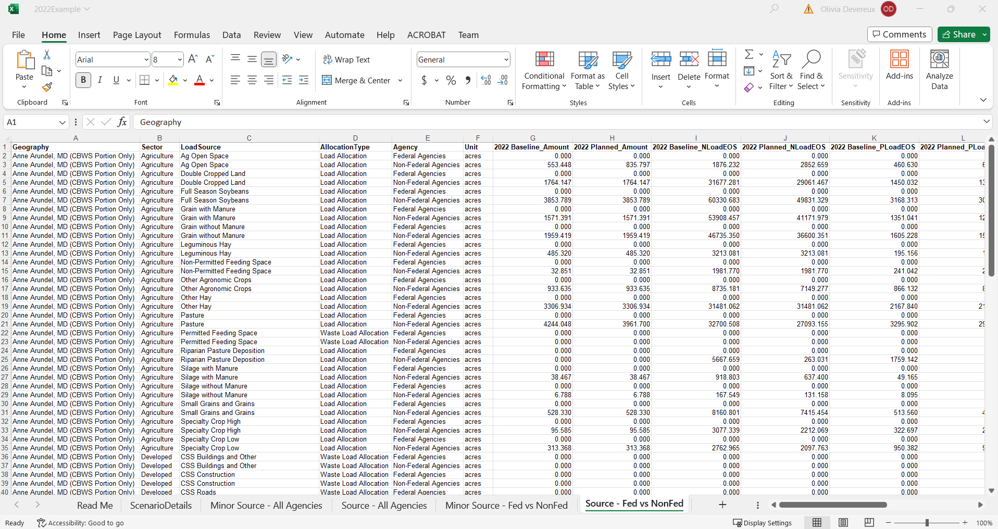

Slide 69
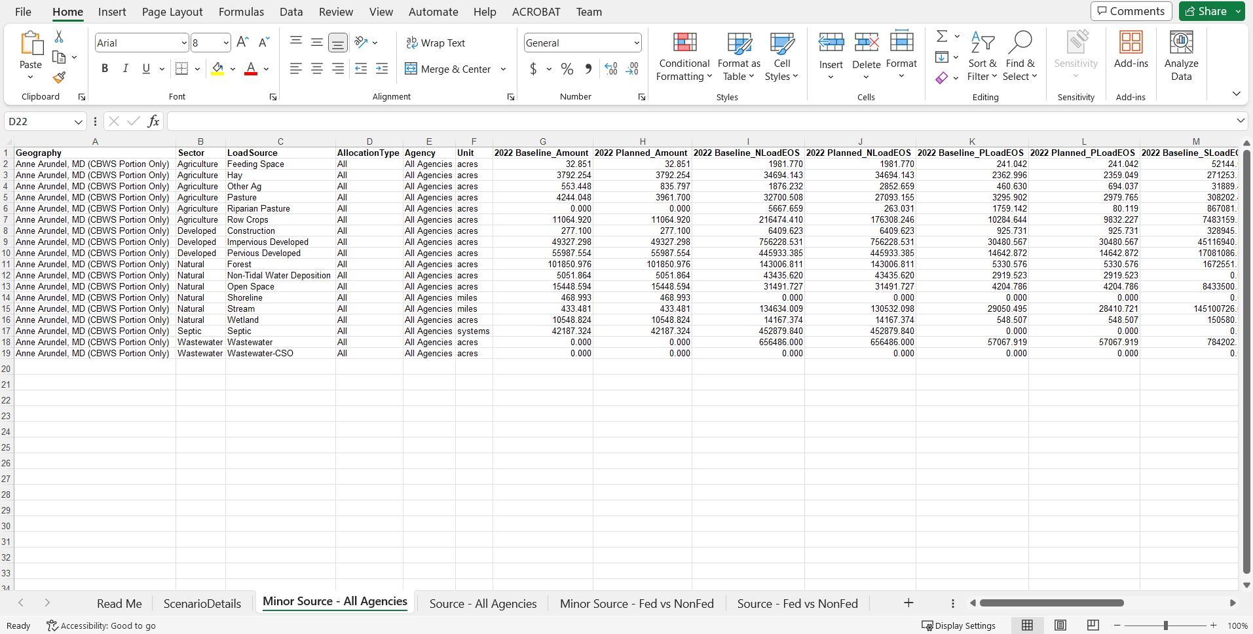
Notes:
Grass buffers, ditch BMP,

Slide 70
Resources
1
4
How to get additional information and support from the CAST Team
70

Slide 71
71

Slide 72
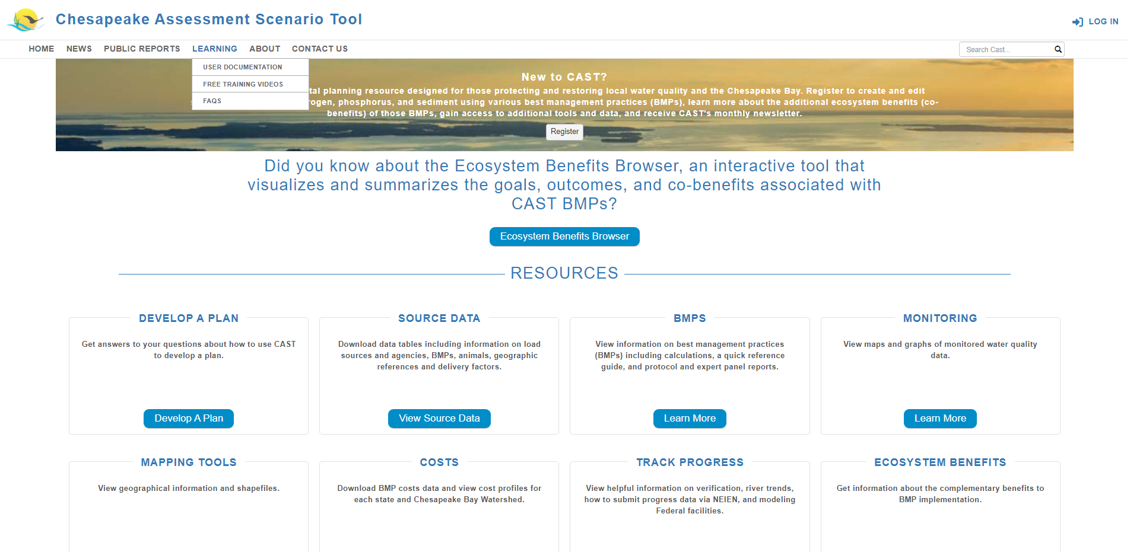
72

Slide 73
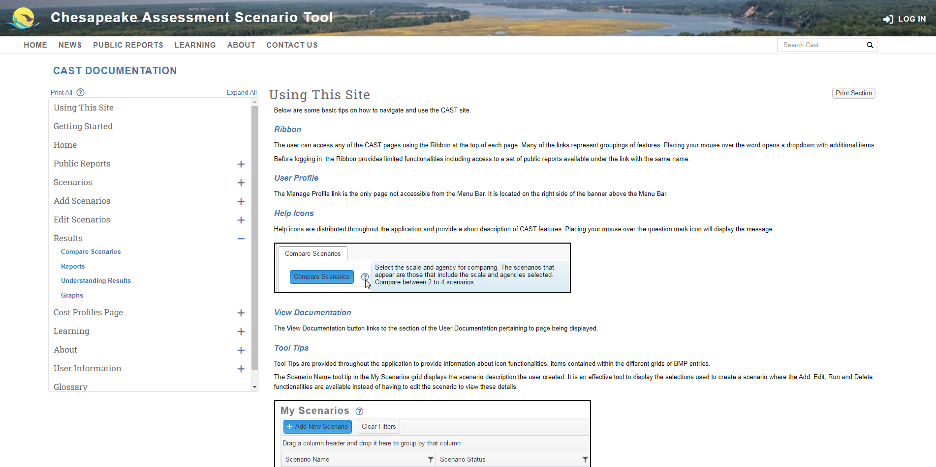
73

Slide 74
74

Slide 75
75

Slide 76
76

Slide 77
77

Slide 78
78

Slide 79
79

Slide 80
80

Slide 81
81

Slide 82
82

Slide 83
83

Slide 84
84

Slide 85
Steps to Developing a Plan
85

Slide 86
86

Slide 87
Source Data
Download data tables including information on load sources and agencies, BMPs, animals, geographic references and delivery factors. The Source Data includes the following data tables:
Load Source Definitions
BMP Definitions
Efficiency BMPs
Load Source Conversion BMPs
Load Reduction BMPs
Animal BMPs
BMP Units
BMP Load Source Group
Load Source Group Components
BMP Animal Group
Animal Group Components
Geographic References
Geographic Scale and Names
Agencies
Delivery Factors
87

Slide 88
88

Slide 89
BMPs
Each BMP is developed following a Protocol that was approved by the Chesapeake Bay Program Partnership. The protocol and detailed reports for each BMP are available on the BMPs page. A quick reference guide for BMPs provides general information about some BMPs and how they function within the Chesapeake Bay Program reporting and modeling structure. This Guide provides a single place to learn key information about a selection of BMPs.
The following resources are available on the CAST BMP page:
Protocol for the Development, Review, and Approval of Loading and Effectiveness Estimates for Nutrient and Sediment Controls in the Chesapeake Bay Watershed Model
Expert Panel Reports
Pasture Management/Grazing Report
Simpson Weammert-Lane 2009 Report with detailed documentation of many BMPs
BMP Reference Guide
Manure BMP Fast Facts
Manure Treatment Technologies Fast Facts
Credit for Conservation Landscaping
89

Slide 90
90

Slide 91
Monitoring
View maps and graphs of monitored water quality data.
Comparisons between the modeled and monitored data can be found on the non-tidal water quality dashboard. These visual representations show both the loads estimated from the U.S. Geologic Survey’s Weighted Regressions on Time, Discharge and Season (WRTDS) and loads estimated from the time-variable Phase 6 Watershed Model.
91

Slide 92
92

Slide 93
Mapping Tools
View geographical information and shapefiles. Shapefiles are available for download as GIS layers and KMZ files.
BMP targeting maps have been created using CAST delivery factors and 2022 Progress loads to communicate which land-river segments in the watershed would be most effective for BMP targeting. There are six bivariate targeting maps, one for each nutrient and sector.
93

Slide 94
94

Slide 95
95

Slide 96
Costs
Download BMP costs data and cost profiles for each state and Chesapeake Bay Watershed.
The chart provided offers a quick look at the average cost per pound of nitrogen or phosphorus reduced and the average nitrogen or phosphorus pound reduced per BMP unit.
96

Slide 97
Thank you!
Olivia Devereux
Olivia@DevereuxConsulting.com
CAST.ChesapeakeBay.net
DevereuxConsulting.com
97

