Slide 1
BMPs for Crediting toward the Conowingo WIP
Olivia Devereux & Tim Paris
Watershed Technical Workgroup
July 6, 2023

Slide 2
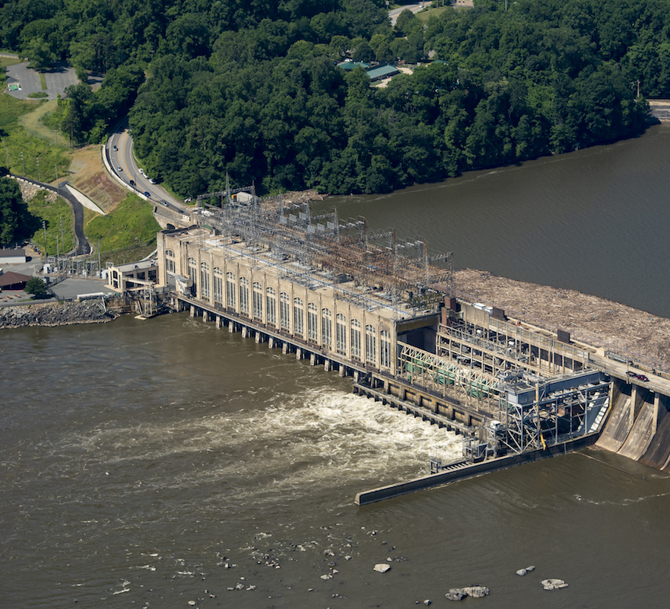
Agenda
Conowingo WIPs and the State WIPs
Tracking Progress Toward the WIPs
Reporting BMPs for Conowingo WIP crediting

Slide 3
Watershed implementation plans
The third iteration of WIPs were established in 2018-2019 to further demonstrate how the jurisdictions plan to have practices in place by 2025 to meet the Phase III WIP planning targets
  Planning targets are at the state and state-basin scales
The expected loads that the Phase 3 WIPs addressed did not include the increased load from the Conowingo dams on the Susquehanna River reaching dynamic equilibrium
The Conowingo WIP (CWIP) was established in 2021 to address this increased load
  The CWIP is in addition to the required load reductions addressed by the Phase 3 WIPs
BMPs implemented as part of the CWIP are tracked separately from the Phase 3 WIPs
Climate change is another additional load and was addressed by Phase 3 WIP addendums or through the 2-year milestones

Slide 4
Tracking Progress
A method for attributing CWIP BMPs has been available in the NEIEN schema since 2018
The process for evaluating CWIP progress compared to overall progress will follow the steps below
  Generate loads from CAST with all BMPs (CWIP and WIP3) = all BMPs loads
  Generate load from CAST without the CWIP BMPs = WIP3 only BMPs
  Determine the difference = CWIP load
  All BMPs load – WIP3 BMPs load = CWIP load

Slide 5
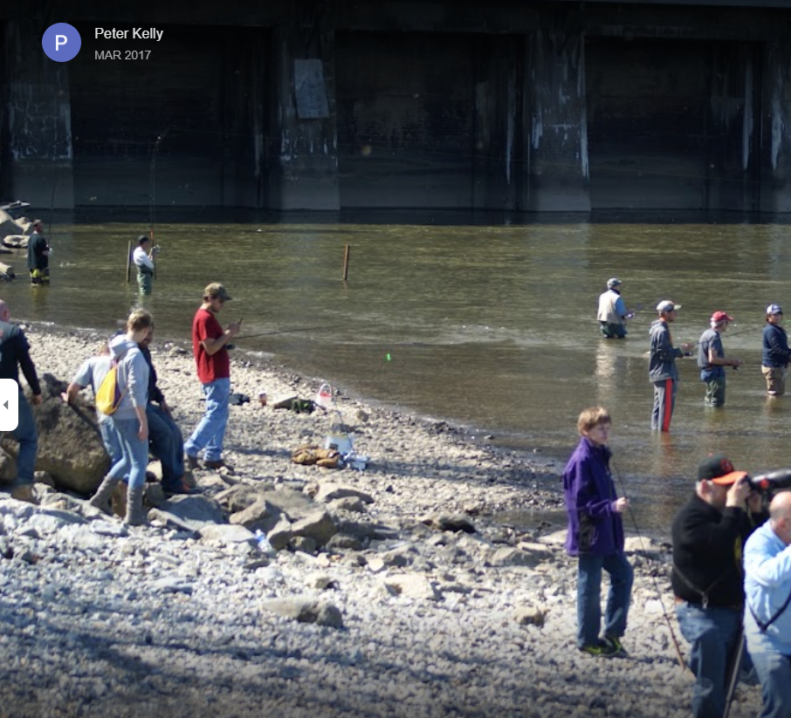
Reporting Requirements
Report using the existing National Environmental Information Exchange Network (NEIEN) schema – no change
Populate the BMPLabel element with the word ‘Conowingo’
  The input of ‘Conowingo’ is not case sensitive
  Blank values for BMPLabel will be assumed to be for the Phase 3 WIPs

Slide 6
NEIEN Schema – BMP Label
<NPSBMPIdentity>
………
  <BMPIdentity>
  <BMPType>
  <BMPTypeCode>AGR</BMPTypeCode>
  <BMPTypeCodeDescription>Agricultural</BMPTypeCodeDescription>
  </BMPType>
  <BMPNameData>
  <BMPName>Tree/Shrub Establishment</BMPName>
  <BMPNameType>
  <BMPNameTypeCode>FED</BMPNameTypeCode>
  <BMPNameTypeCodeDescription>FEDERAL</BMPNameTypeCodeDescription>
  </BMPNameType>
  </BMPNameData>
  <NPSMeasure>
  <MeasureValue>3.00</MeasureValue>
  <MeasureUnit>
  <MeasureUnitCode>ACRE</MeasureUnitCode>
  <MeasureUnitName>Acres</MeasureUnitName>
  </MeasureUnit>
  <MeasureName>Acres</MeasureName>
  </NPSMeasure>
  <BmpLabel>Conowingo</BmpLabel>
  <StateUniqueIdentifier>13273</StateUniqueIdentifier>
  <ImplementationQualifier>IMFW</ImplementationQualifier>
  </BMPIdentity>
  ……….
</NPSBMPIdentity>
Conowingo Label

